Slide 1
Tectonic Geomorphology 2nd Edition Burbank and Anderson
Chapter 3: Establishing timing in the landscape: dating methods
Figures, Boxes, Plates, Tables

Slide 2
Burbank and Anderson, 2011, Tectonic Geomorphology, Chapter 3

Slide 3
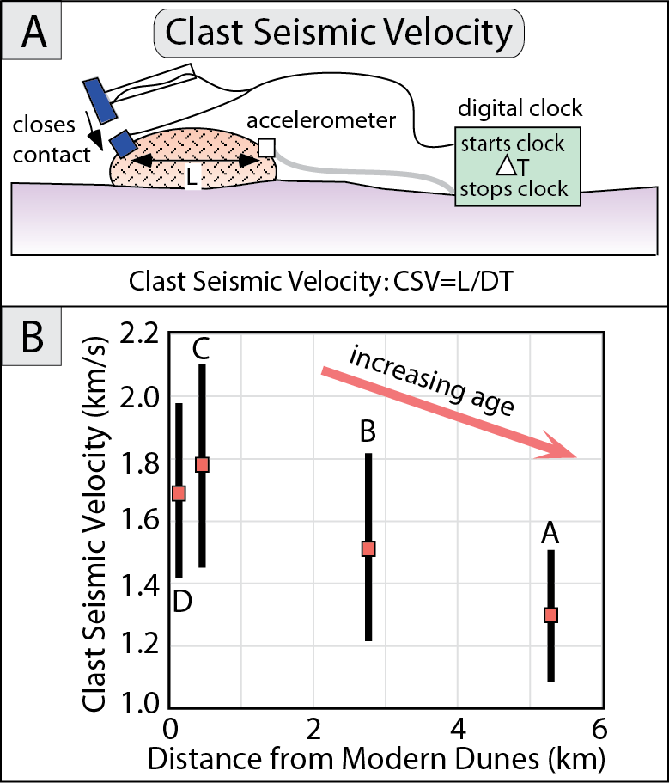
Burbank and Anderson, 2011, Tectonic Geomorphology, Chapter 3

Slide 4
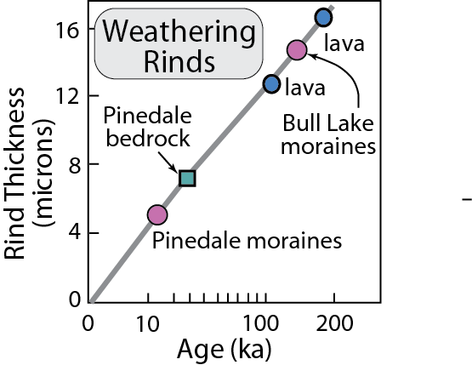
Burbank and Anderson, 2011, Tectonic Geomorphology, Chapter 3

Slide 5
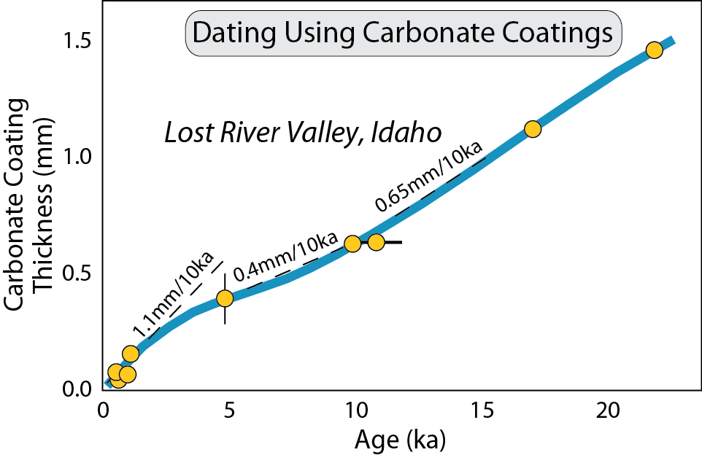
Burbank and Anderson, 2011, Tectonic Geomorphology, Chapter 3

Slide 6
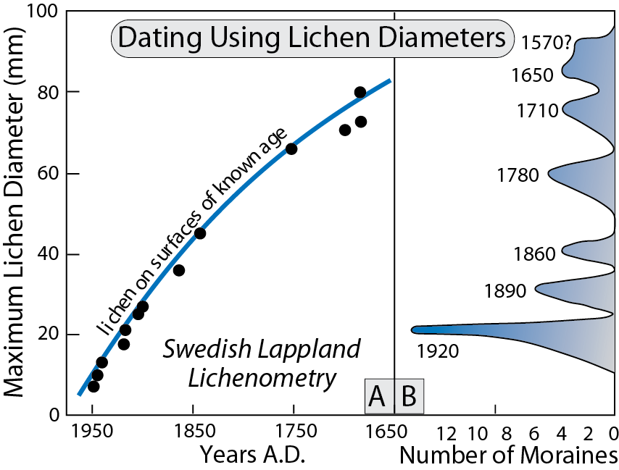
Burbank and Anderson, 2011, Tectonic Geomorphology, Chapter 3

Slide 7
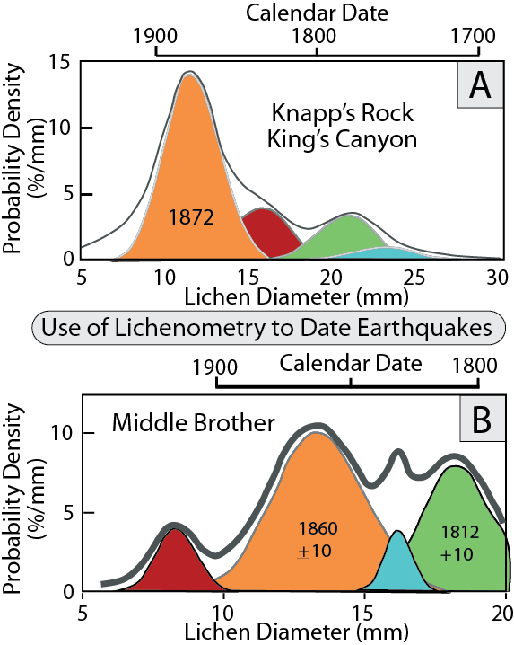
Burbank and Anderson, 2011, Tectonic Geomorphology, Chapter 3

Slide 8
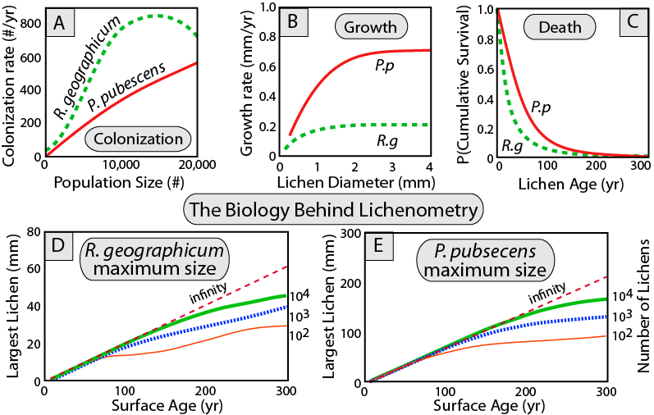
Burbank and Anderson, 2011, Tectonic Geomorphology, Chapter 3

Slide 9
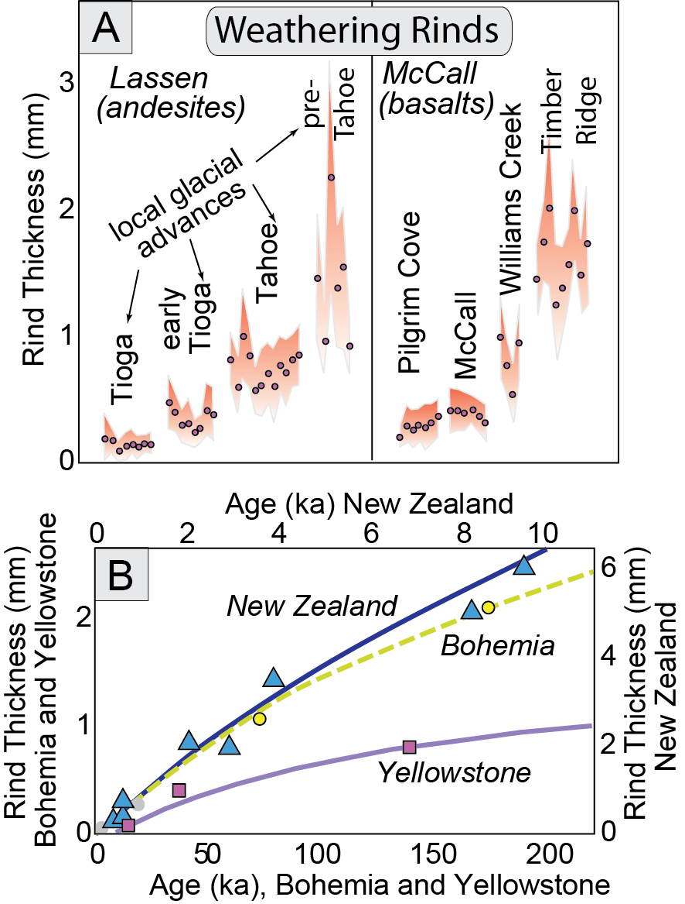
Burbank and Anderson, 2011, Tectonic Geomorphology, Chapter 3

Slide 10
Burbank and Anderson, 2011, Tectonic Geomorphology, Chapter 3

Slide 11
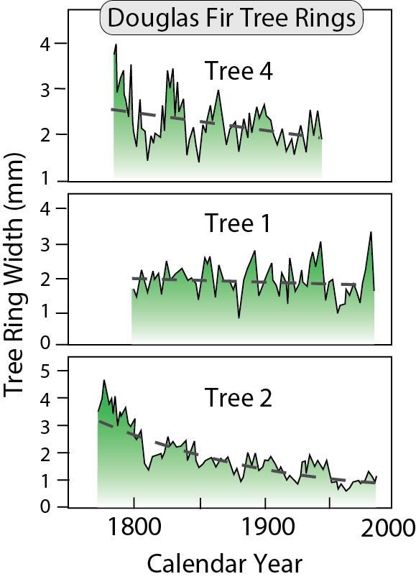
Burbank and Anderson, 2011, Tectonic Geomorphology, Chapter 3

Slide 12
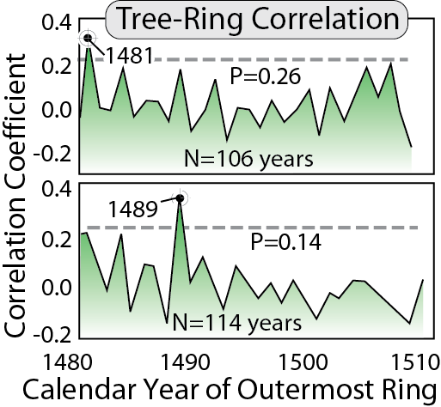
Burbank and Anderson, 2011, Tectonic Geomorphology, Chapter 3

Slide 13
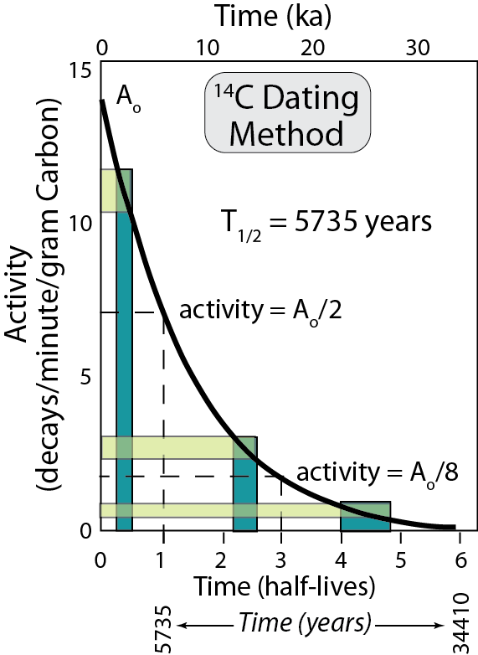
Burbank and Anderson, 2011, Tectonic Geomorphology, Chapter 3

Slide 14
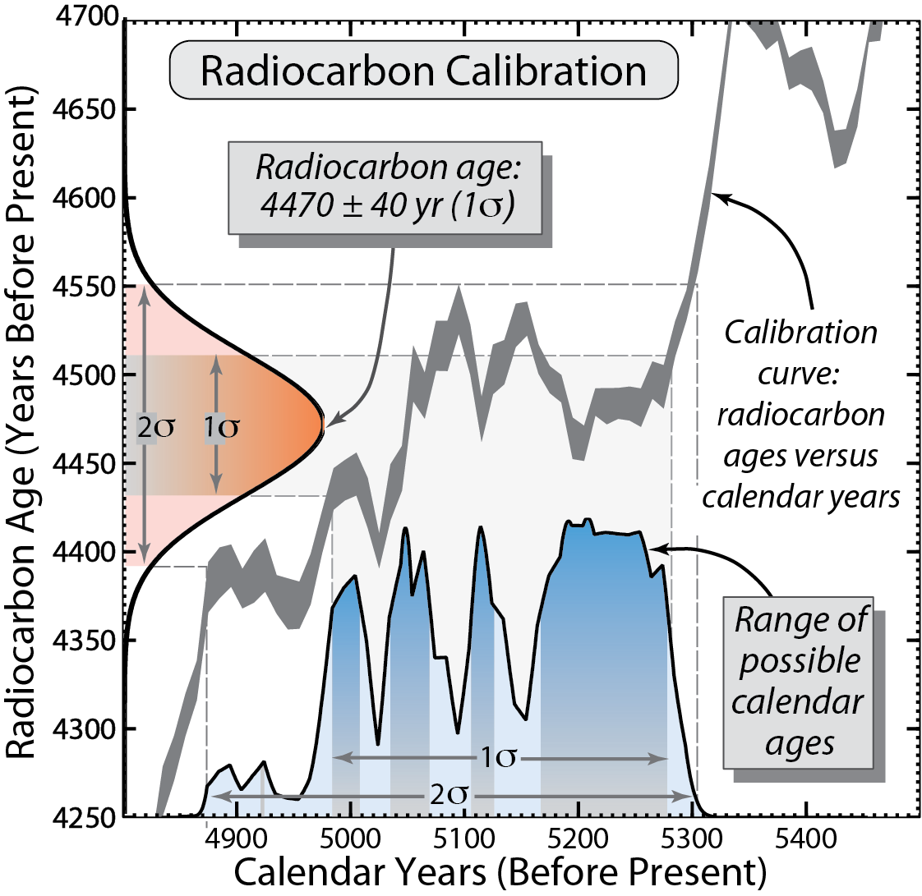
Burbank and Anderson, 2011, Tectonic Geomorphology, Chapter 3

Slide 15
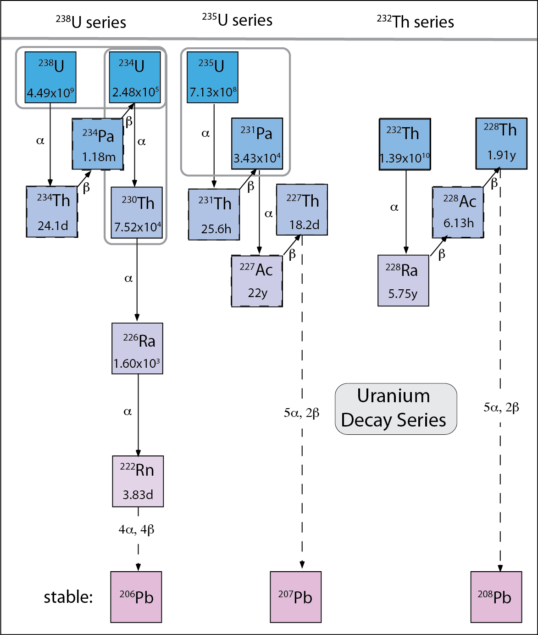
Burbank and Anderson, 2011, Tectonic Geomorphology, Chapter 3

Slide 16
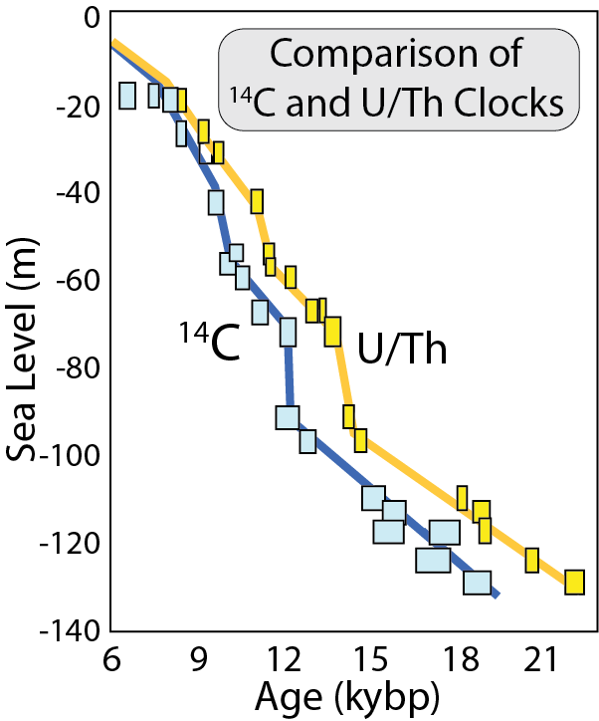
Burbank and Anderson, 2011, Tectonic Geomorphology, Chapter 3

Slide 17
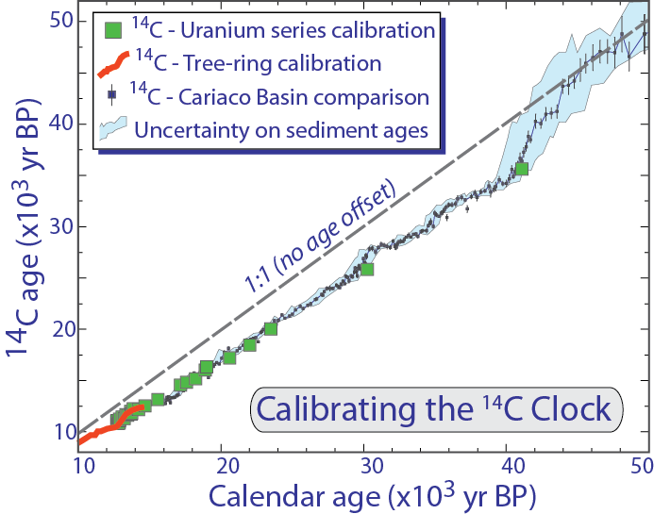
Burbank and Anderson, 2011, Tectonic Geomorphology, Chapter 3

Slide 18
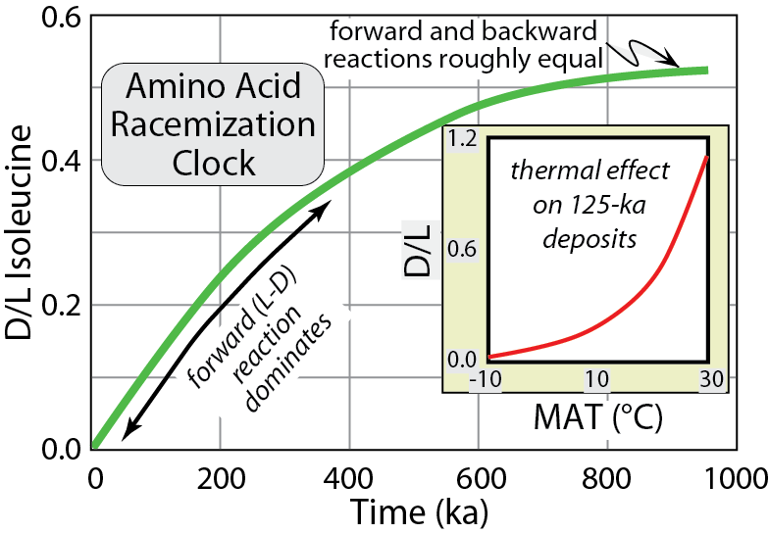
Burbank and Anderson, 2011, Tectonic Geomorphology, Chapter 3

Slide 19
Burbank and Anderson, 2011, Tectonic Geomorphology, Chapter 3

Slide 20
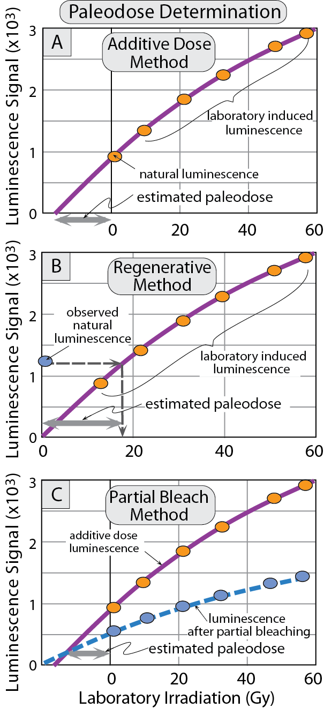
Burbank and Anderson, 2011, Tectonic Geomorphology, Chapter 3

Slide 21
Burbank and Anderson, 2011, Tectonic Geomorphology, Chapter 3

Slide 22
Burbank and Anderson, 2011, Tectonic Geomorphology, Chapter 3

Slide 23
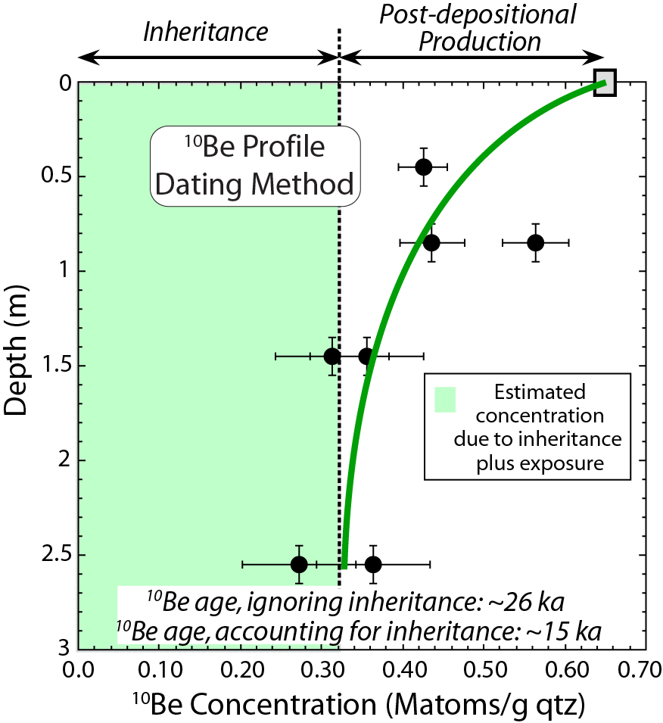
Burbank and Anderson, 2011, Tectonic Geomorphology, Chapter 3

Slide 24
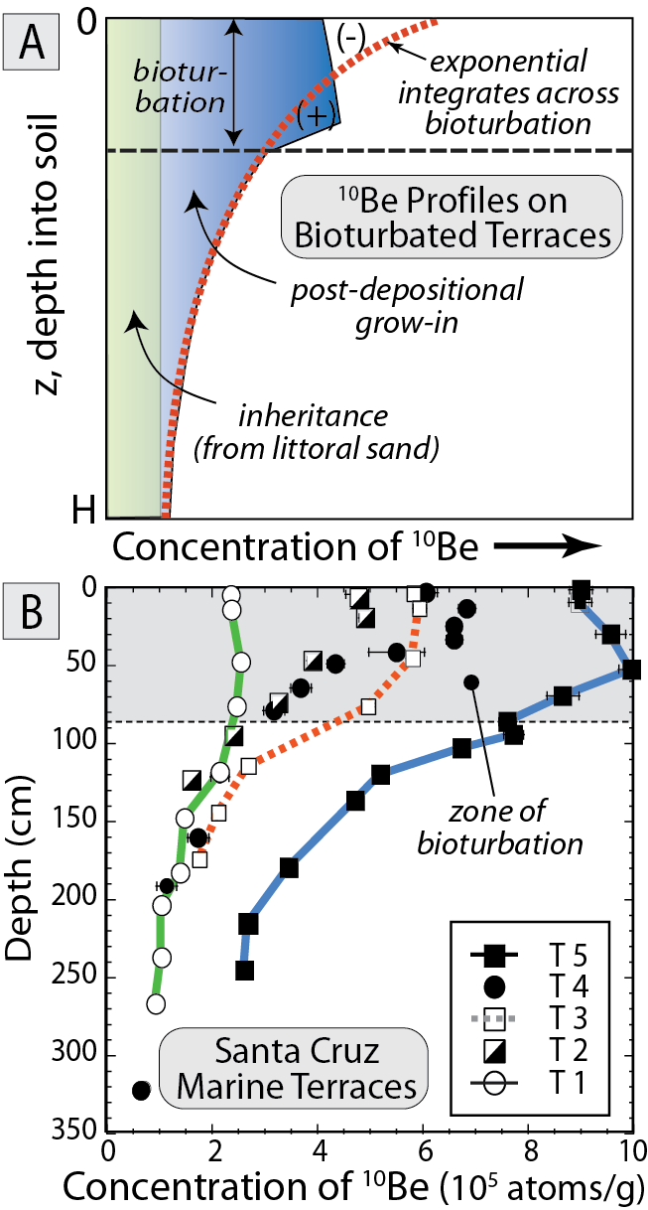
Burbank and Anderson, 2011, Tectonic Geomorphology, Chapter 3

Slide 25
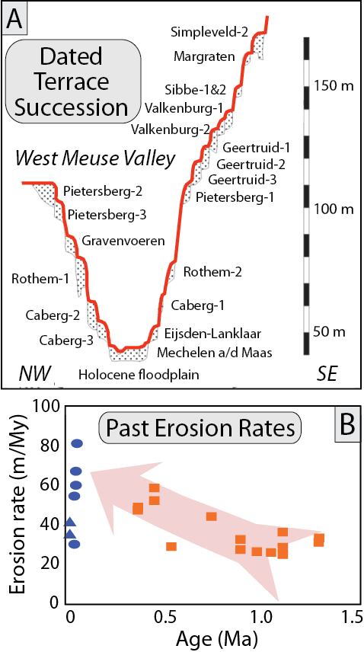
Burbank and Anderson, 2011, Tectonic Geomorphology, Chapter 3

Slide 26
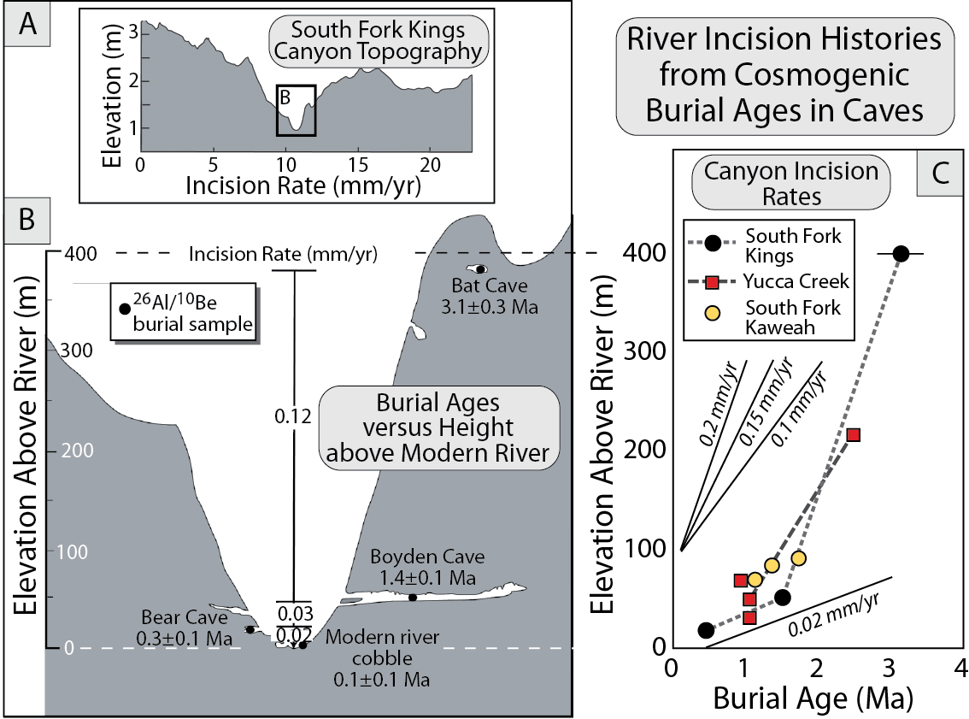
Burbank and Anderson, 2011, Tectonic Geomorphology, Chapter 3

Slide 27
Burbank and Anderson, 2011, Tectonic Geomorphology, Chapter 3

Slide 28
Burbank and Anderson, 2011, Tectonic Geomorphology, Chapter 3

