Slide 1
Tectonic Geomorphology 2nd Edition Burbank and Anderson
Color Plates

Slide 2
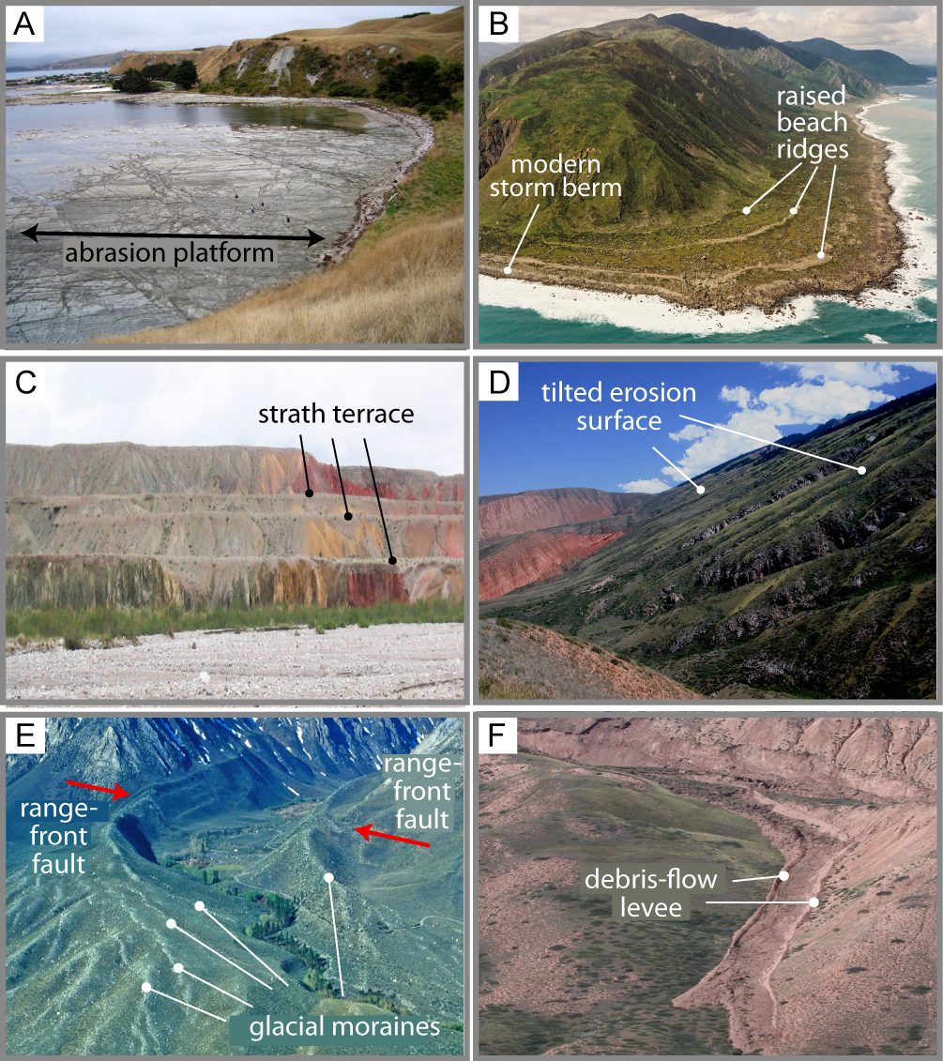
Burbank and Anderson, 2011, Tectonic Geomorphology, Color Plates

Slide 3
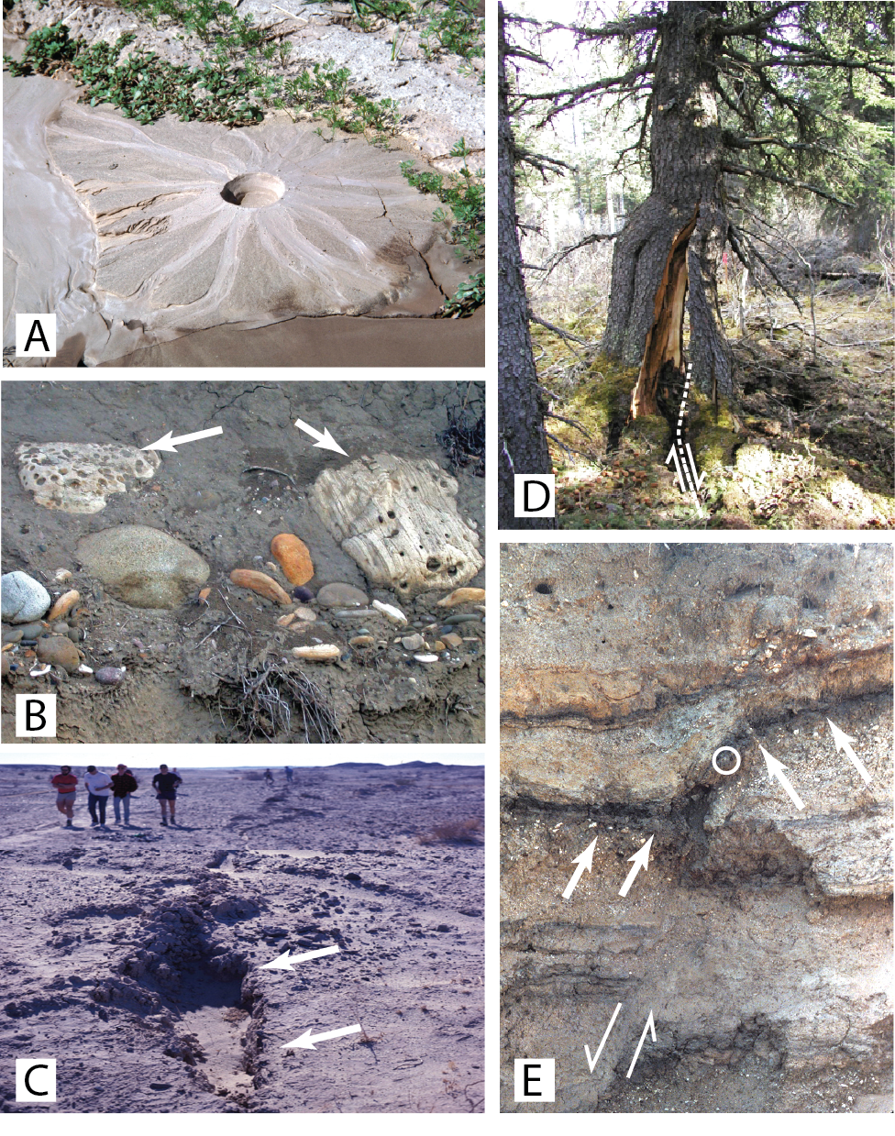
Burbank and Anderson, 2011, Tectonic Geomorphology, Color Plates

Slide 4
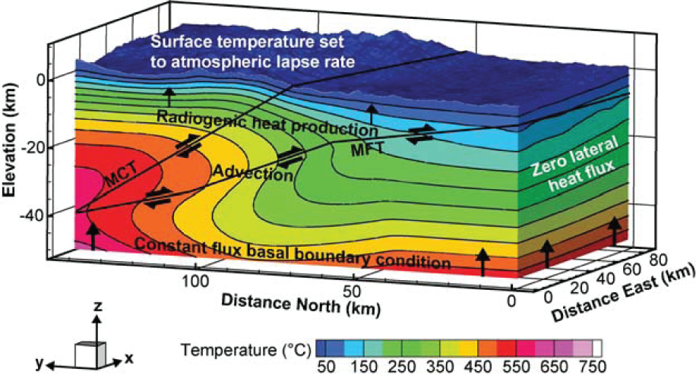
Burbank and Anderson, 2011, Tectonic Geomorphology, Color Plates

Slide 5
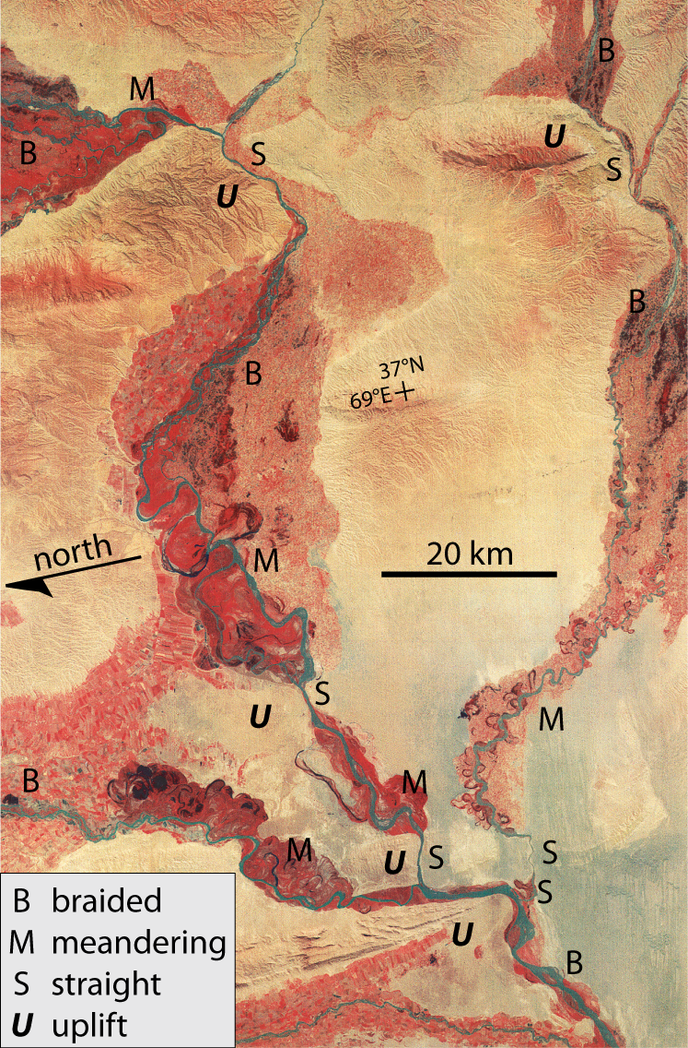
Burbank and Anderson, 2011, Tectonic Geomorphology, Color Plates

Slide 6
Burbank and Anderson, 2011, Tectonic Geomorphology, Color Plates

Slide 7
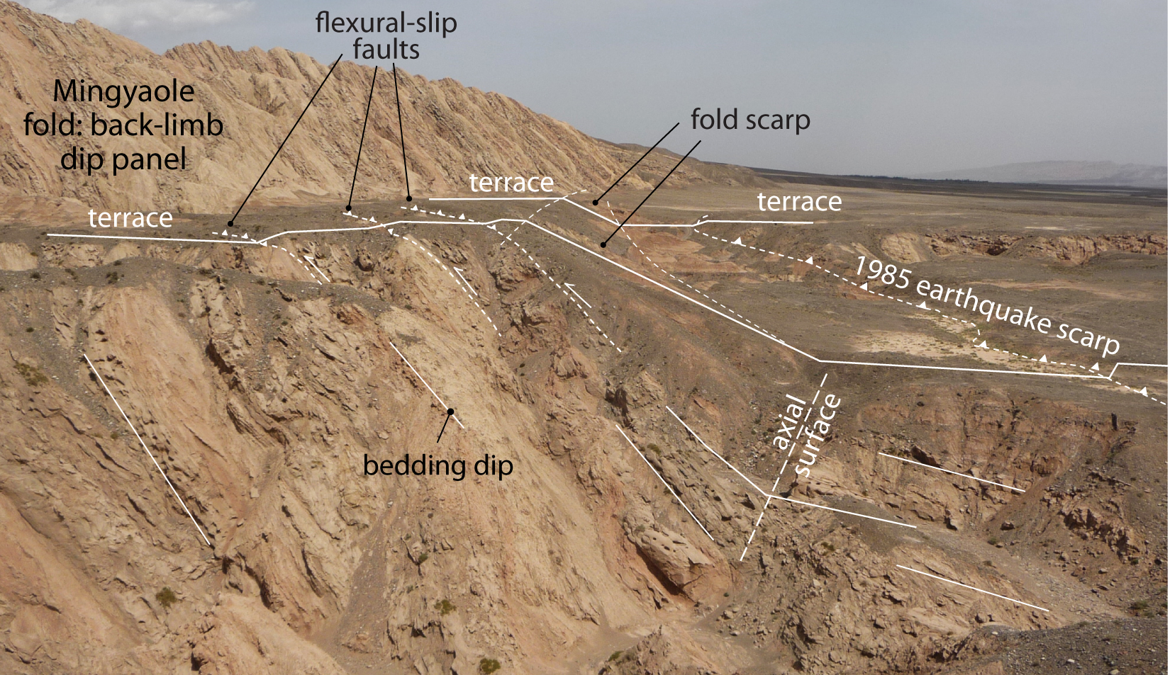
Burbank and Anderson, 2011, Tectonic Geomorphology, Color Plates

Slide 8
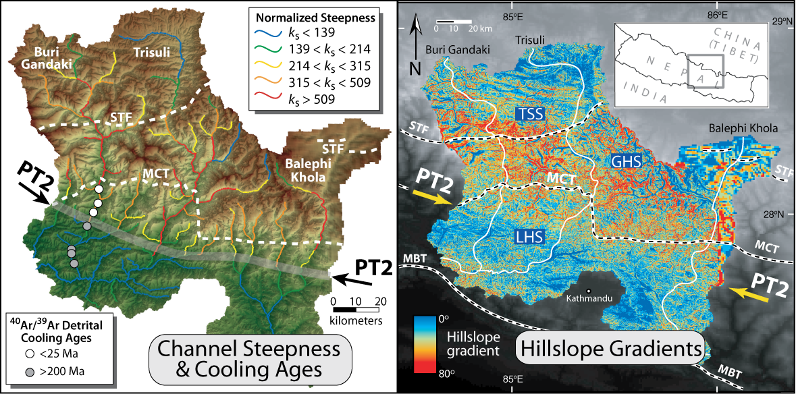
Burbank and Anderson, 2011, Tectonic Geomorphology, Color Plates

Slide 9
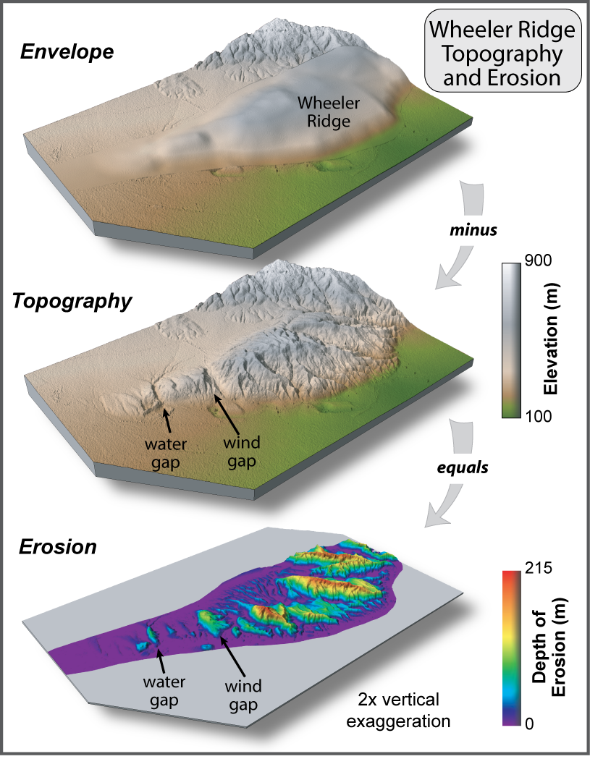
Burbank and Anderson, 2011, Tectonic Geomorphology, Color Plates

Slide 10
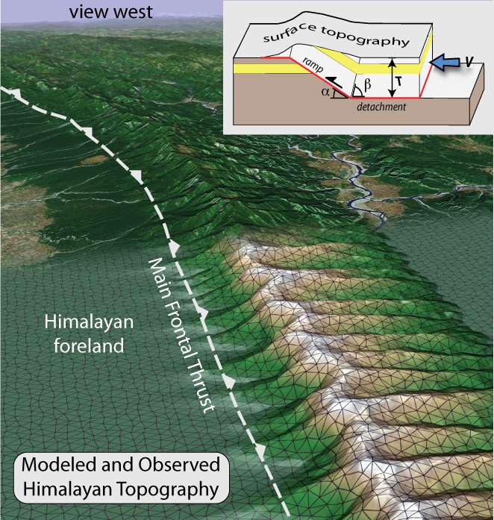
Burbank and Anderson, 2011, Tectonic Geomorphology, Color Plates

Slide 11
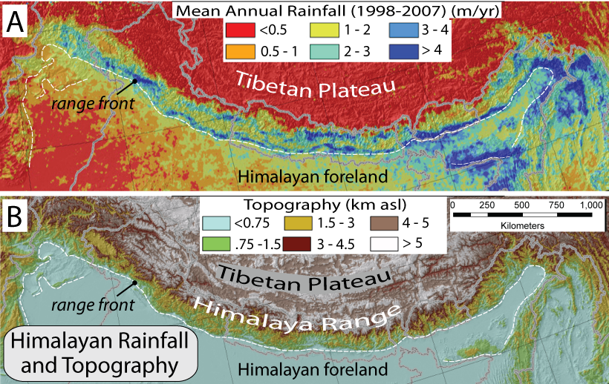
Burbank and Anderson, 2011, Tectonic Geomorphology, Color Plates

Slide 12
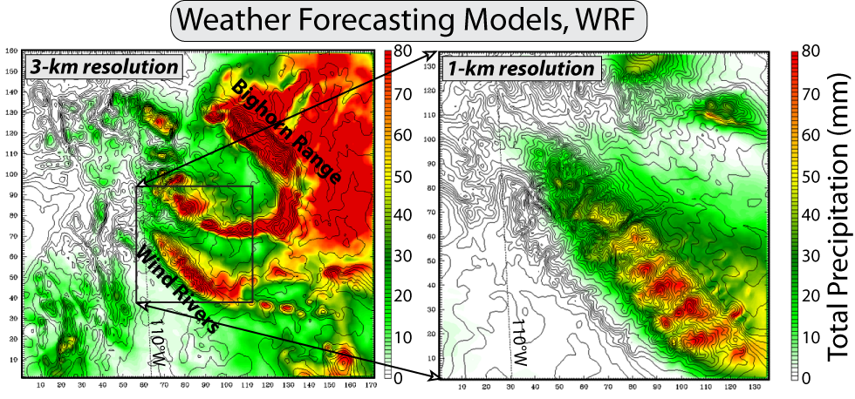
Burbank and Anderson, 2011, Tectonic Geomorphology, Color Plates

Slide 13
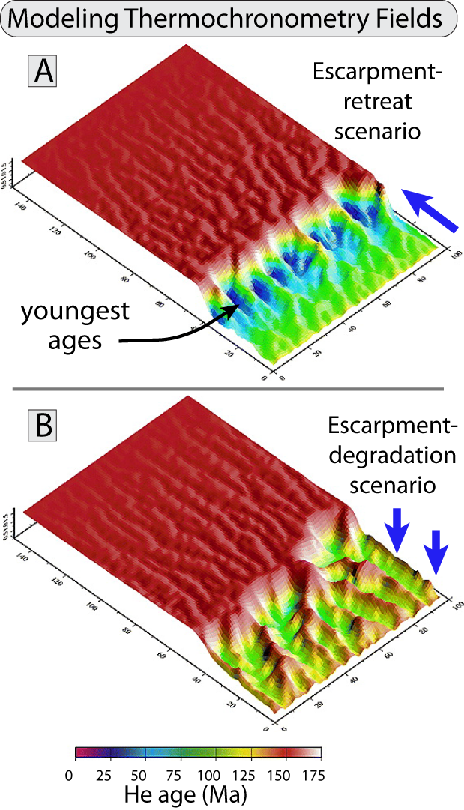
Burbank and Anderson, 2011, Tectonic Geomorphology, Color Plates

Slide 14
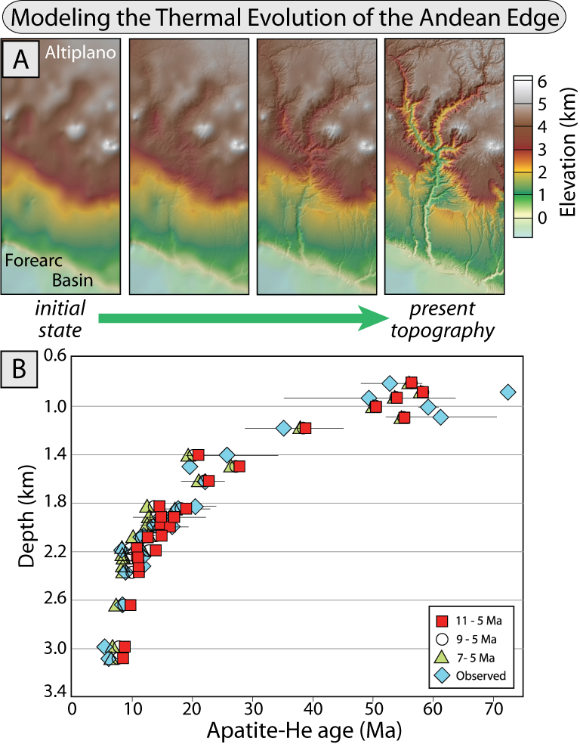
Burbank and Anderson, 2011, Tectonic Geomorphology, Color Plates

Slide 15
Burbank and Anderson, 2011, Tectonic Geomorphology, Color Plates

