Slide 1
Tectonic Geomorphology 2nd Edition Burbank and Anderson
Chapter 4: Stress, faults, and folds
Figures, Boxes, Plates, Tables

Slide 2
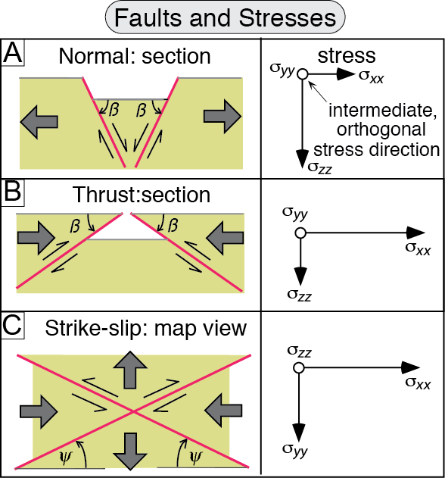
Burbank and Anderson, 2011, Tectonic Geomorphology, Chapter 4

Slide 3
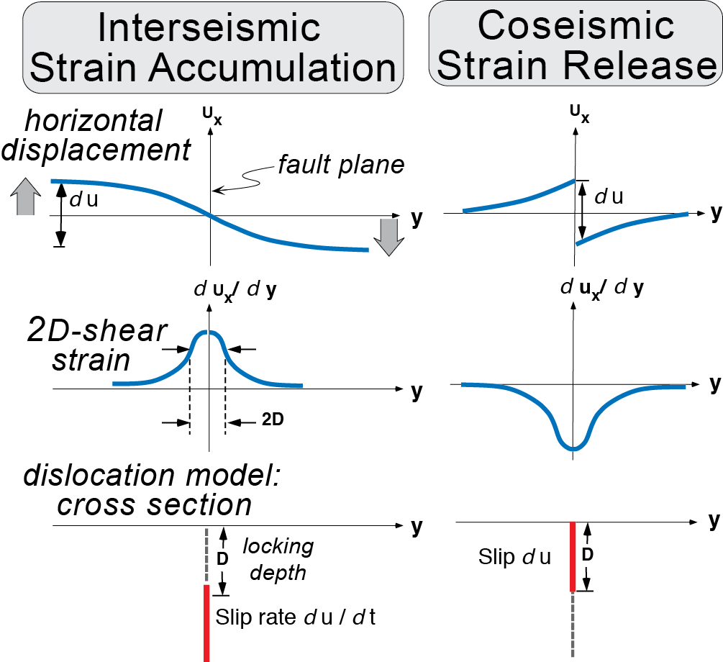
Burbank and Anderson, 2011, Tectonic Geomorphology, Chapter 4

Slide 4
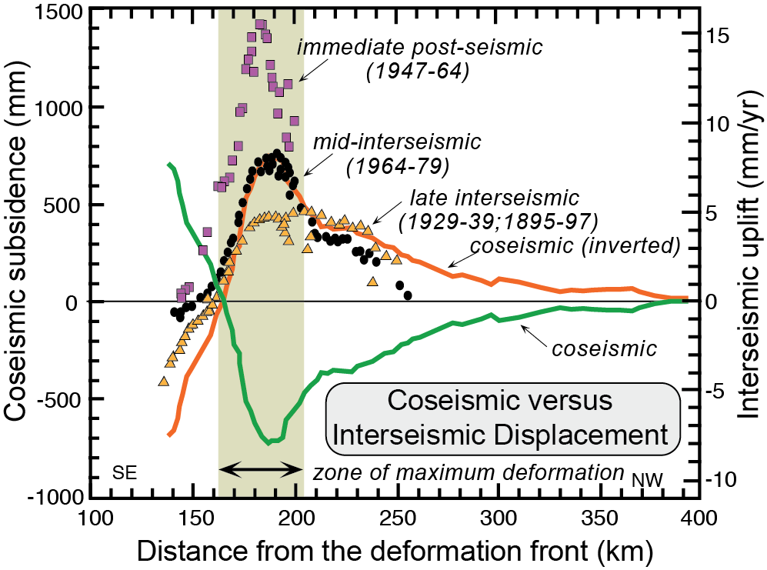
Burbank and Anderson, 2011, Tectonic Geomorphology, Chapter 4

Slide 5
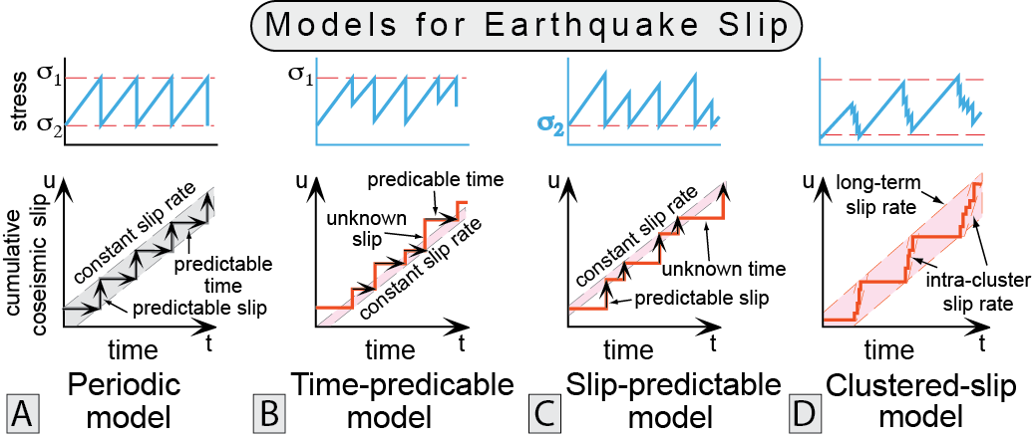
Burbank and Anderson, 2011, Tectonic Geomorphology, Chapter 4

Slide 6
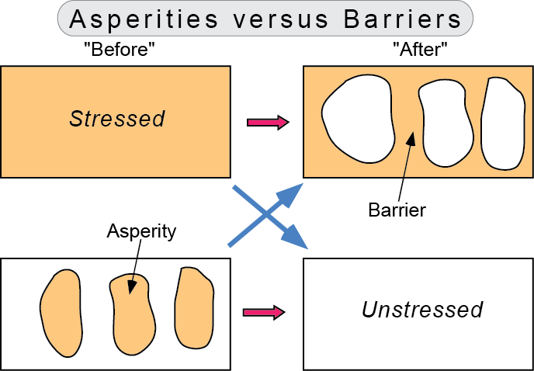
Burbank and Anderson, 2011, Tectonic Geomorphology, Chapter 4

Slide 7
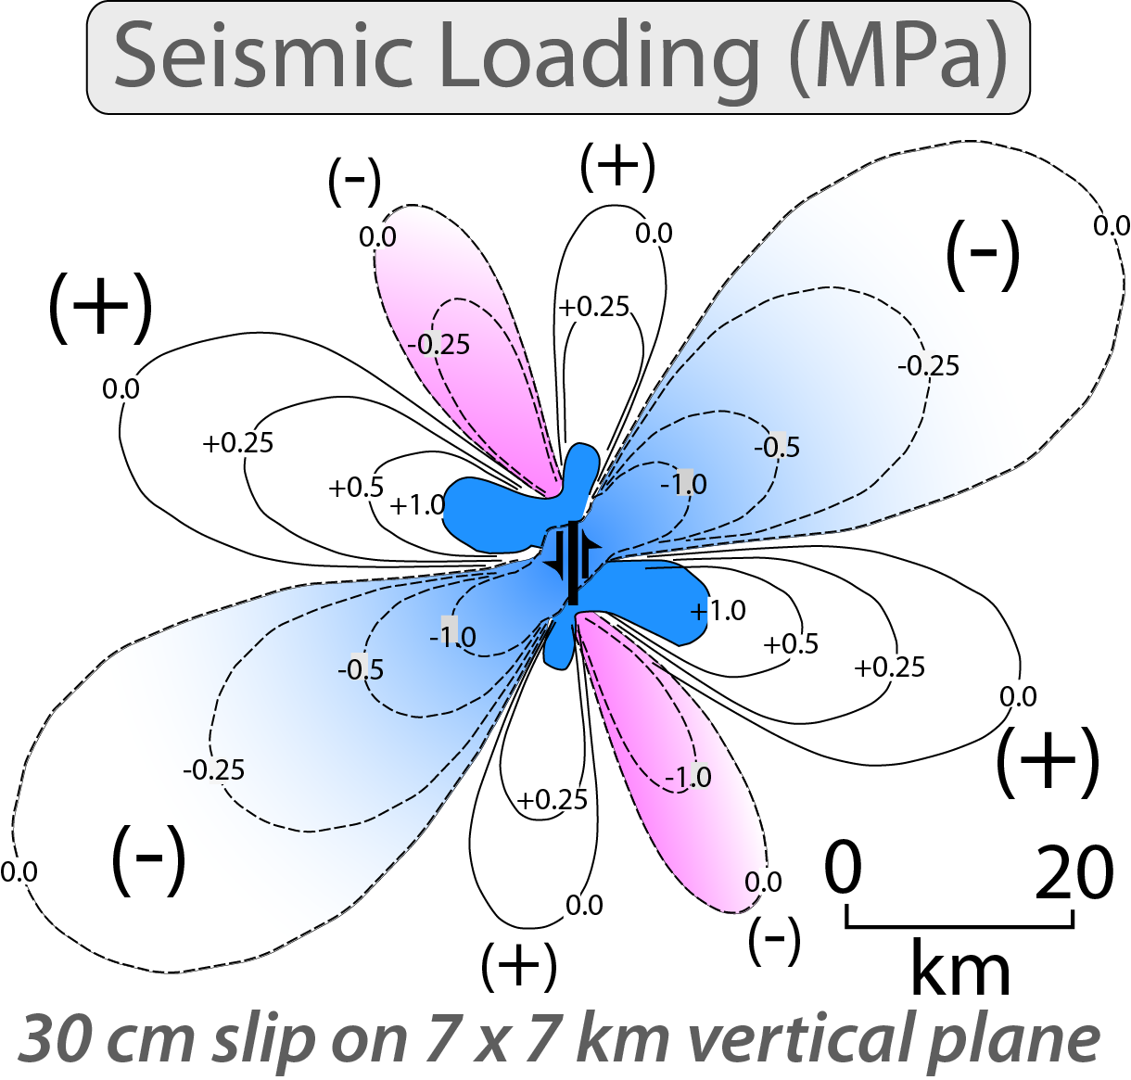
Burbank and Anderson, 2011, Tectonic Geomorphology, Chapter 4

Slide 8
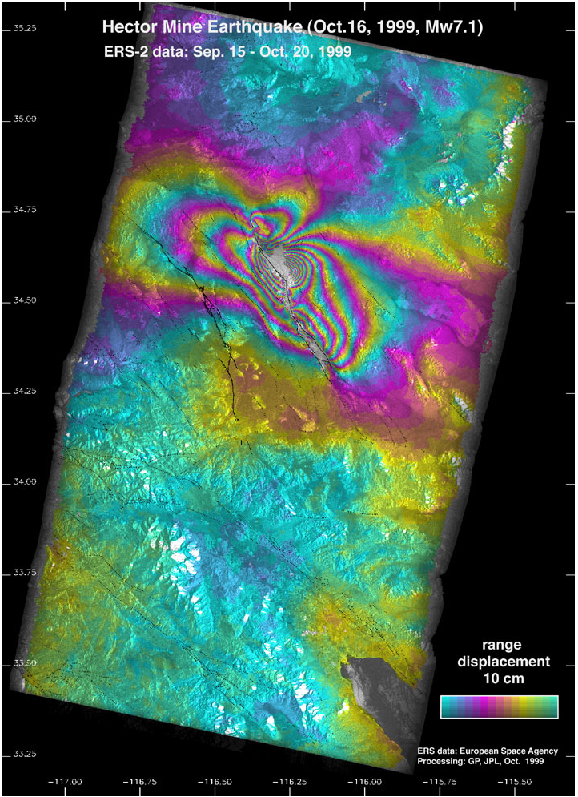
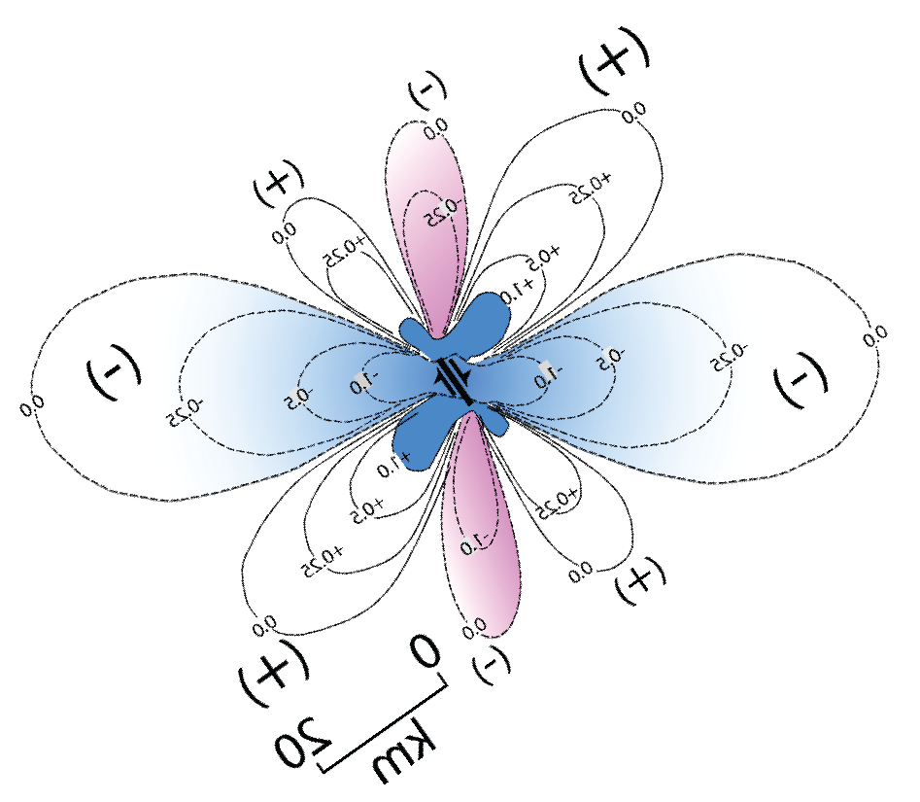
Burbank and Anderson, 2011, Tectonic Geomorphology, Chapter 4

Slide 9
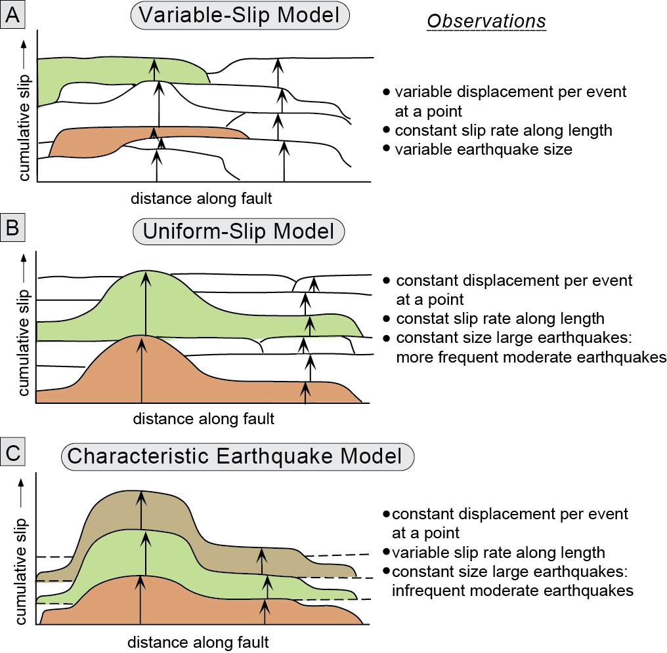
Burbank and Anderson, 2011, Tectonic Geomorphology, Chapter 4

Slide 10
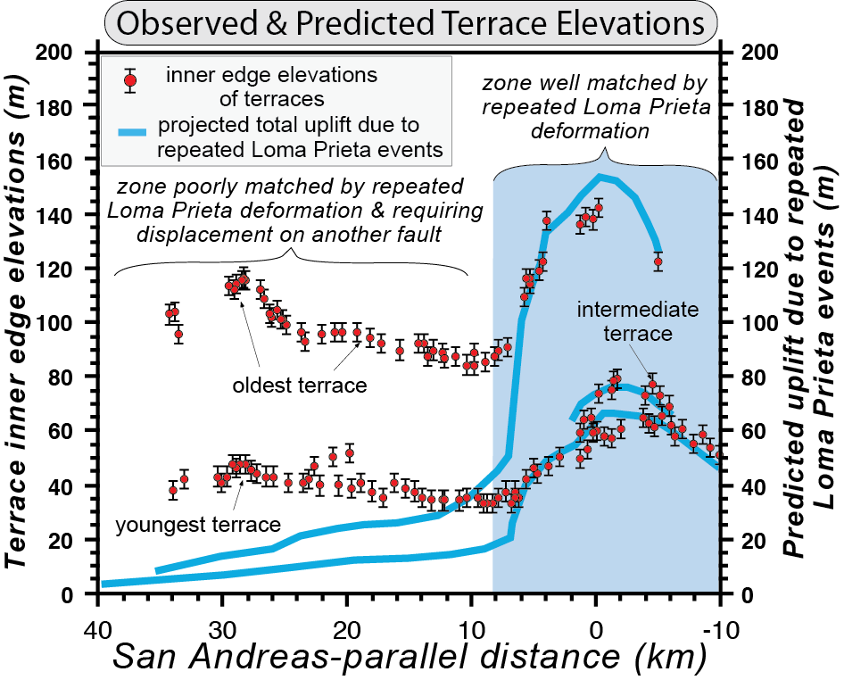
Burbank and Anderson, 2011, Tectonic Geomorphology, Chapter 4

Slide 11
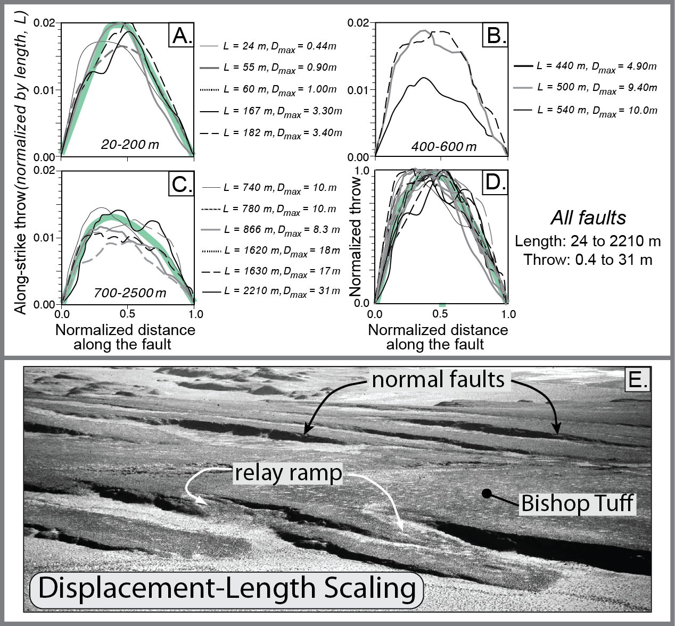
Burbank and Anderson, 2011, Tectonic Geomorphology, Chapter 4

Slide 12
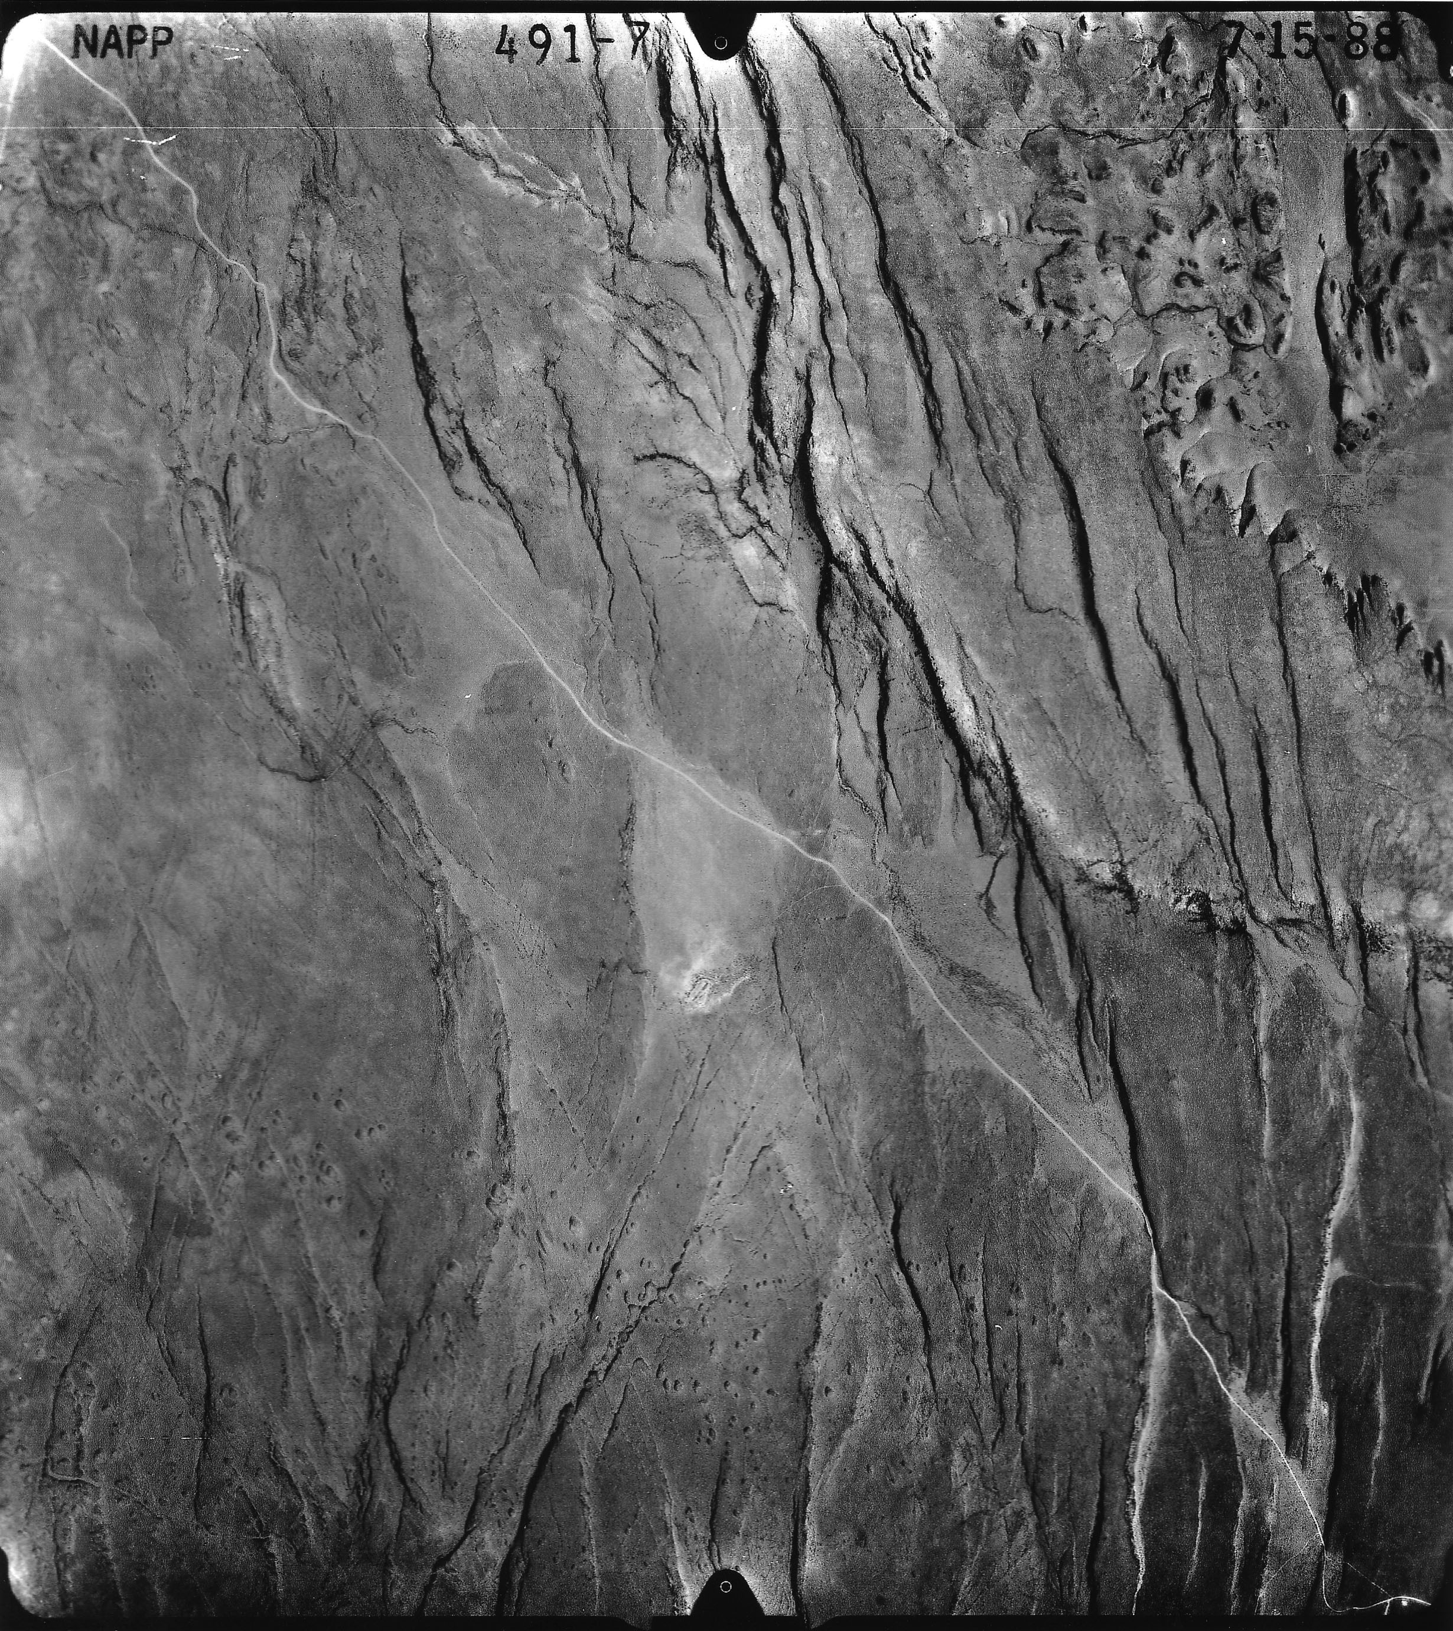
Burbank and Anderson, 2011, Tectonic Geomorphology, Chapter 4

Slide 13
Burbank and Anderson, 2011, Tectonic Geomorphology, Chapter 4

Slide 14
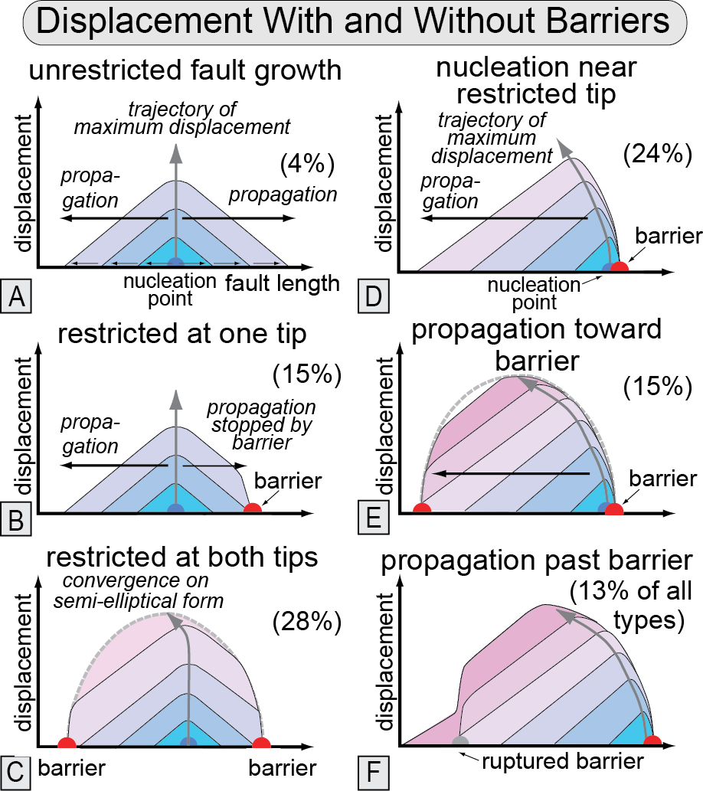
Burbank and Anderson, 2011, Tectonic Geomorphology, Chapter 4

Slide 15
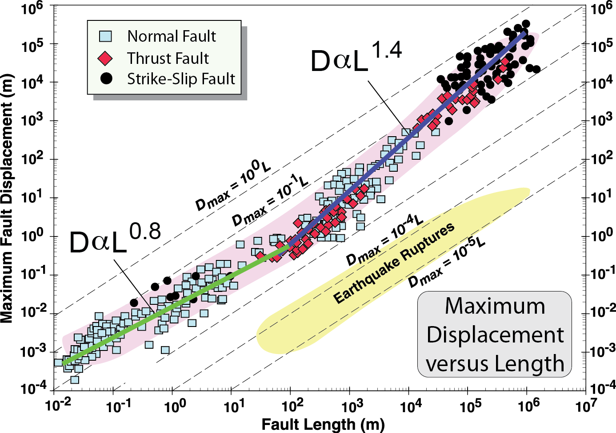
Burbank and Anderson, 2011, Tectonic Geomorphology, Chapter 4

Slide 16
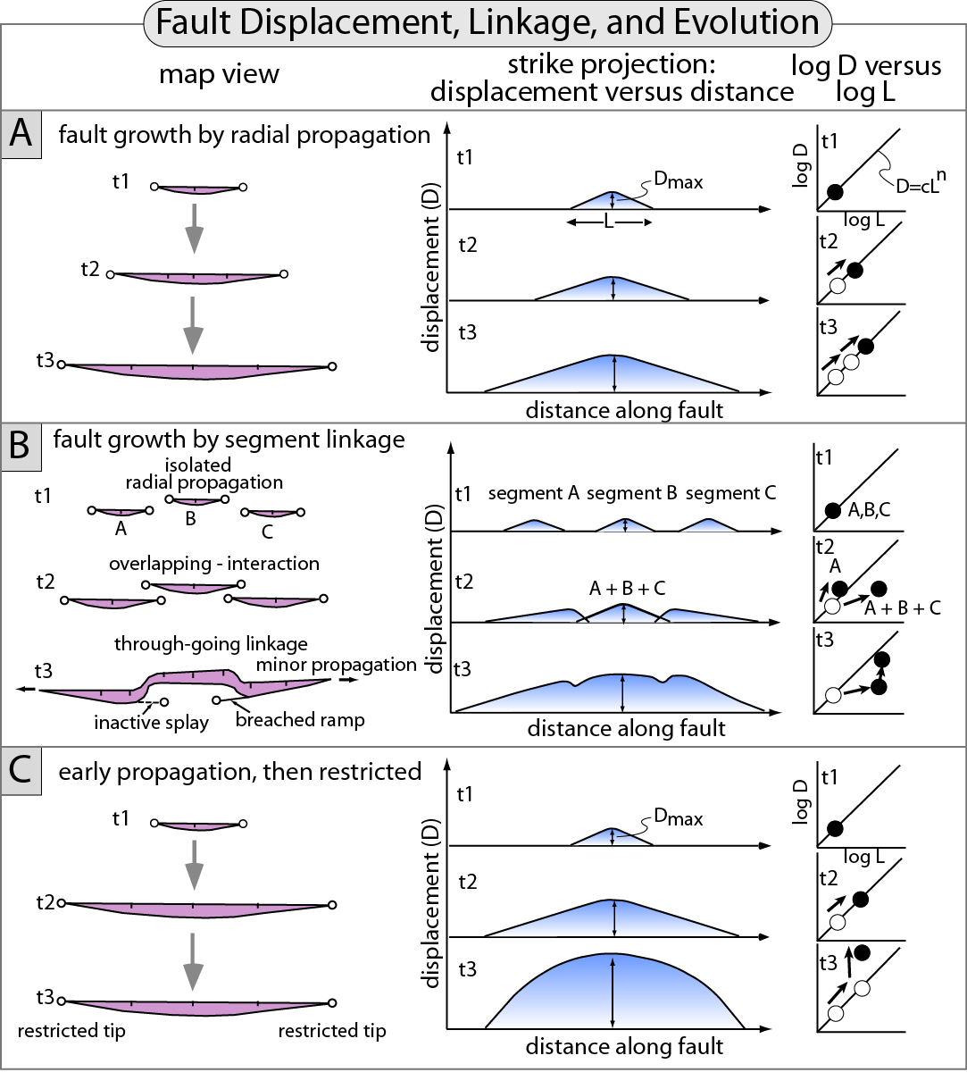
Burbank and Anderson, 2011, Tectonic Geomorphology, Chapter 4

Slide 17
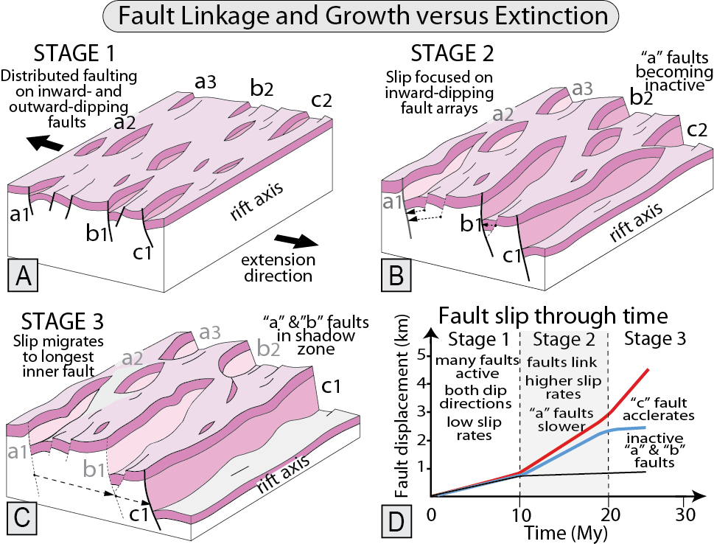
Burbank and Anderson, 2011, Tectonic Geomorphology, Chapter 4

Slide 18
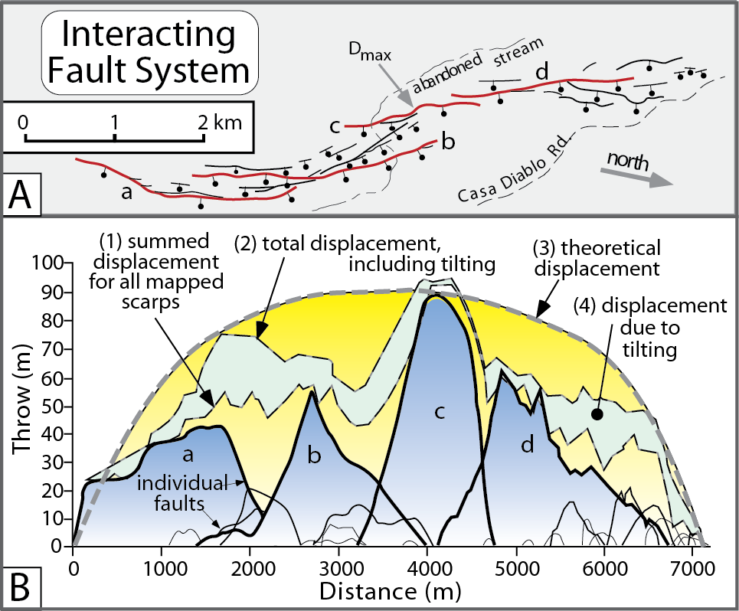
Burbank and Anderson, 2011, Tectonic Geomorphology, Chapter 4

Slide 19
Burbank and Anderson, 2011, Tectonic Geomorphology, Chapter 4

Slide 20
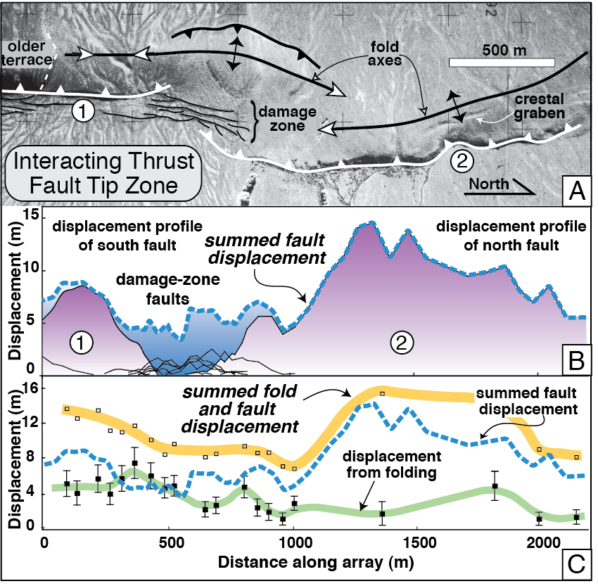
Burbank and Anderson, 2011, Tectonic Geomorphology, Chapter 4

Slide 21
Burbank and Anderson, 2011, Tectonic Geomorphology, Chapter 4

Slide 22
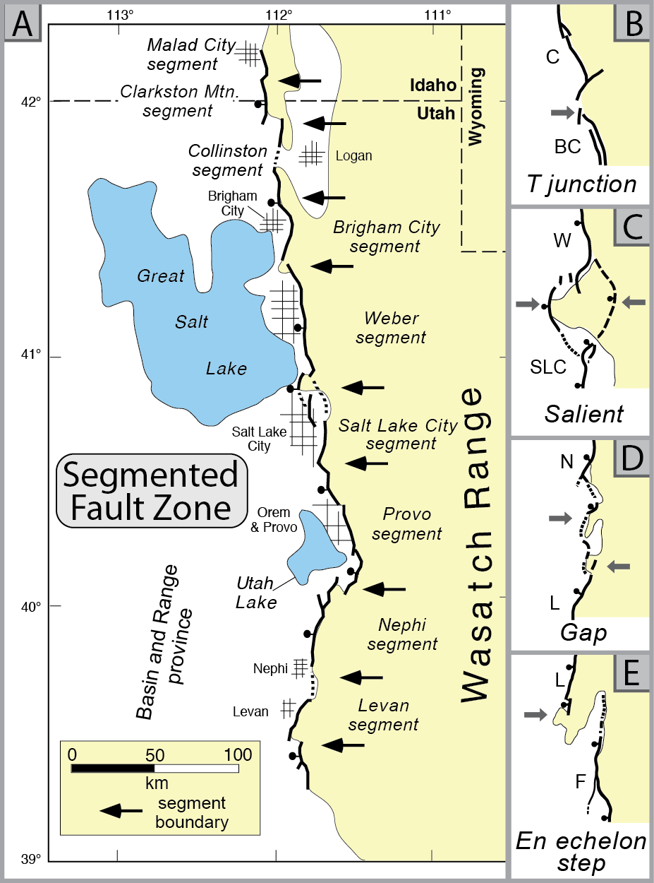
Burbank and Anderson, 2011, Tectonic Geomorphology, Chapter 4

Slide 23
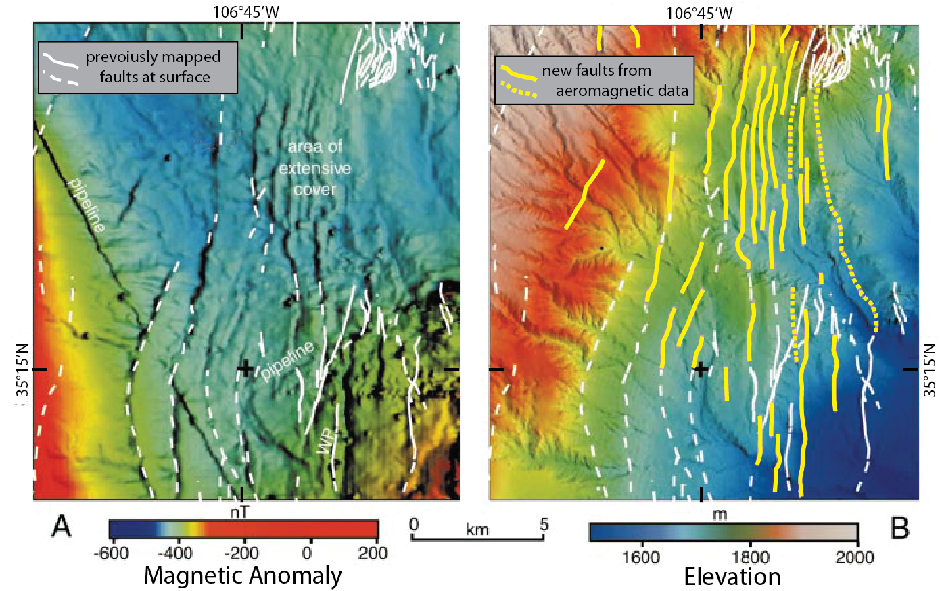
Burbank and Anderson, 2011, Tectonic Geomorphology, Chapter 4

Slide 24
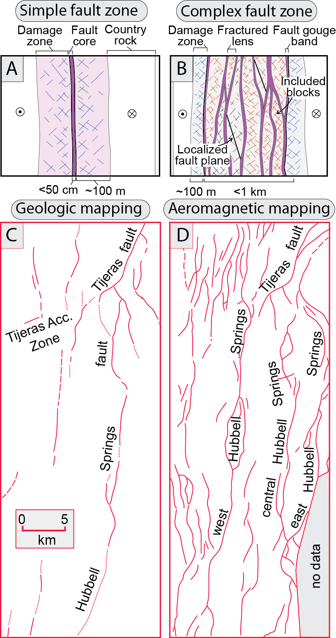
Burbank and Anderson, 2011, Tectonic Geomorphology, Chapter 4

Slide 25
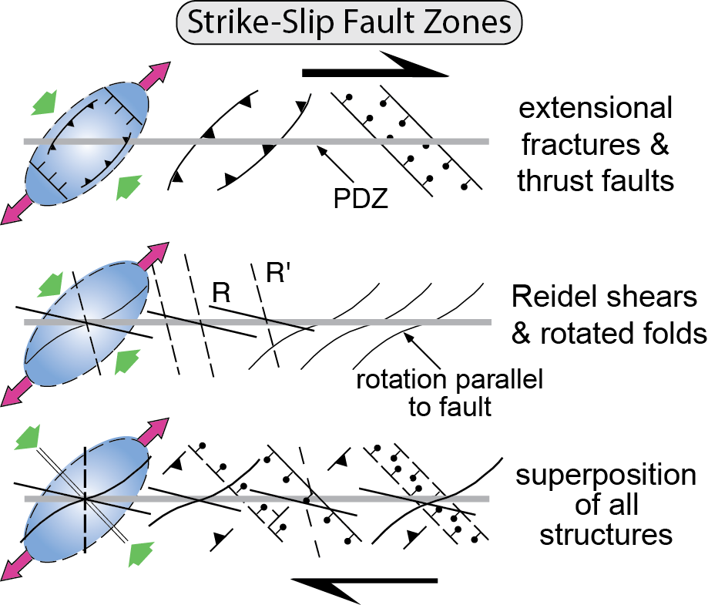
Burbank and Anderson, 2011, Tectonic Geomorphology, Chapter 4

Slide 26
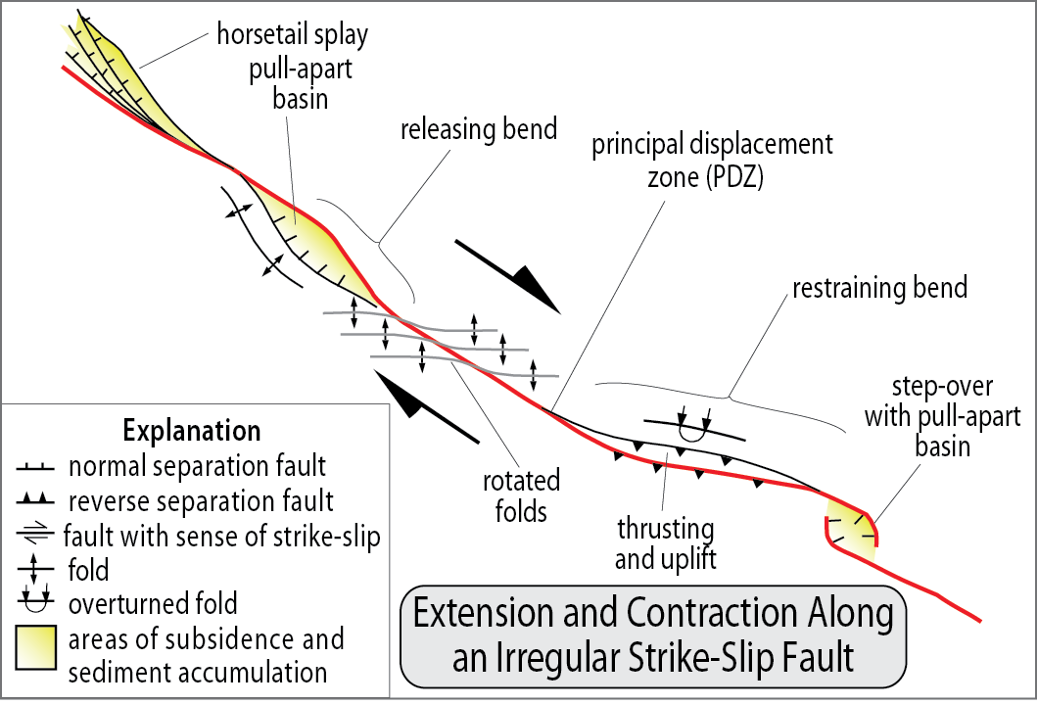
Burbank and Anderson, 2011, Tectonic Geomorphology, Chapter 4

Slide 27
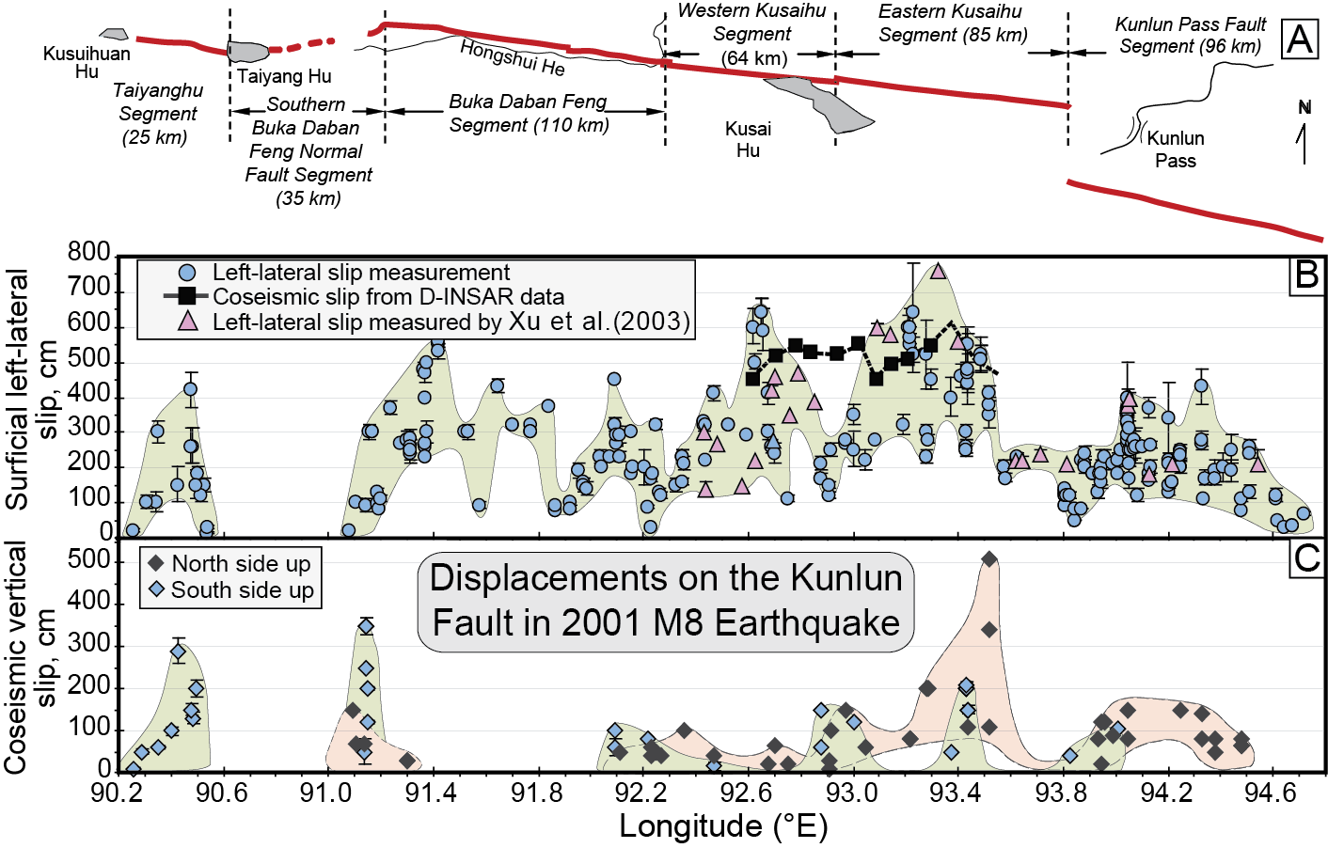
Burbank and Anderson, 2011, Tectonic Geomorphology, Chapter 4

Slide 28
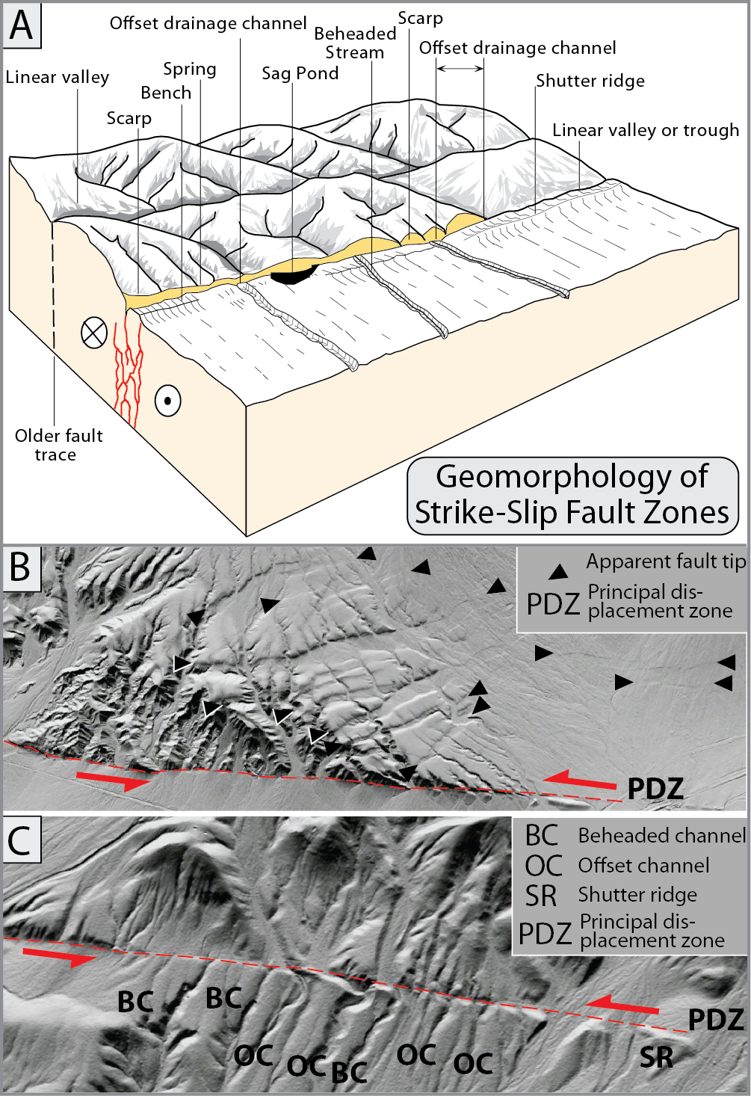
Burbank and Anderson, 2011, Tectonic Geomorphology, Chapter 4

Slide 29
Burbank and Anderson, 2011, Tectonic Geomorphology, Chapter 4

Slide 30
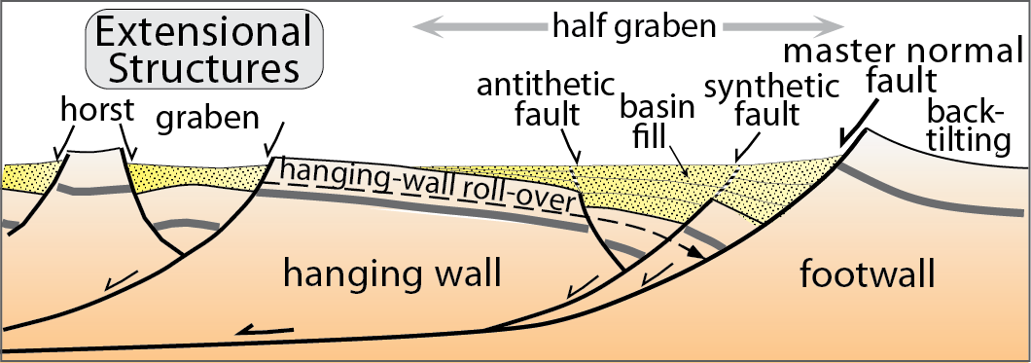
Burbank and Anderson, 2011, Tectonic Geomorphology, Chapter 4

Slide 31
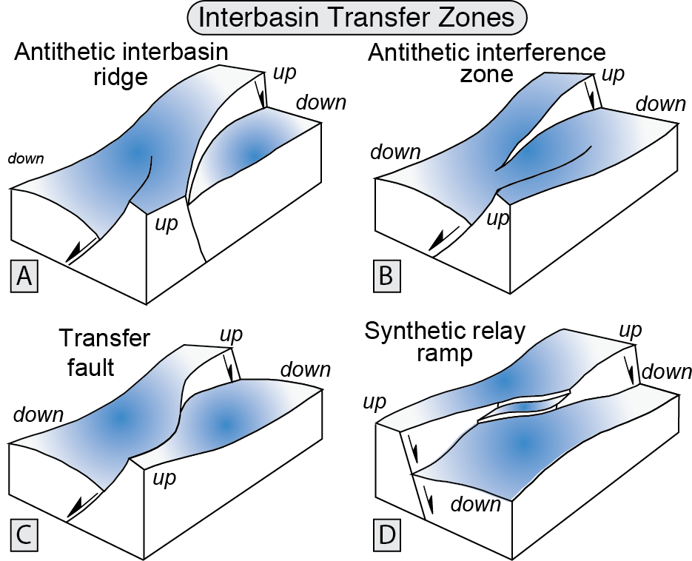
Burbank and Anderson, 2011, Tectonic Geomorphology, Chapter 4

Slide 32
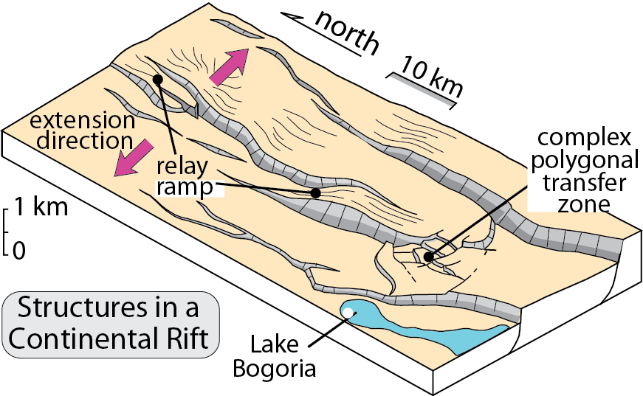
Burbank and Anderson, 2011, Tectonic Geomorphology, Chapter 4

Slide 33
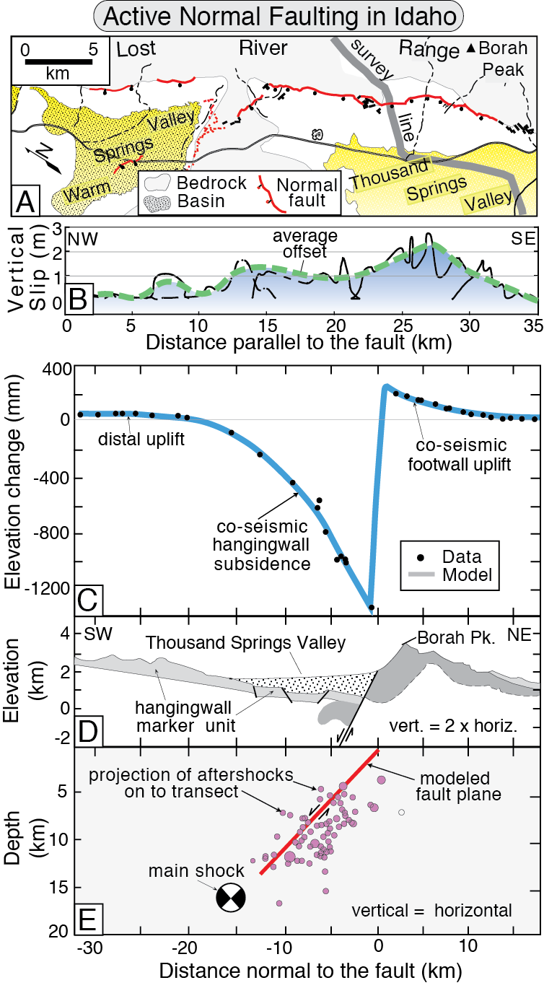
Burbank and Anderson, 2011, Tectonic Geomorphology, Chapter 4

Slide 34
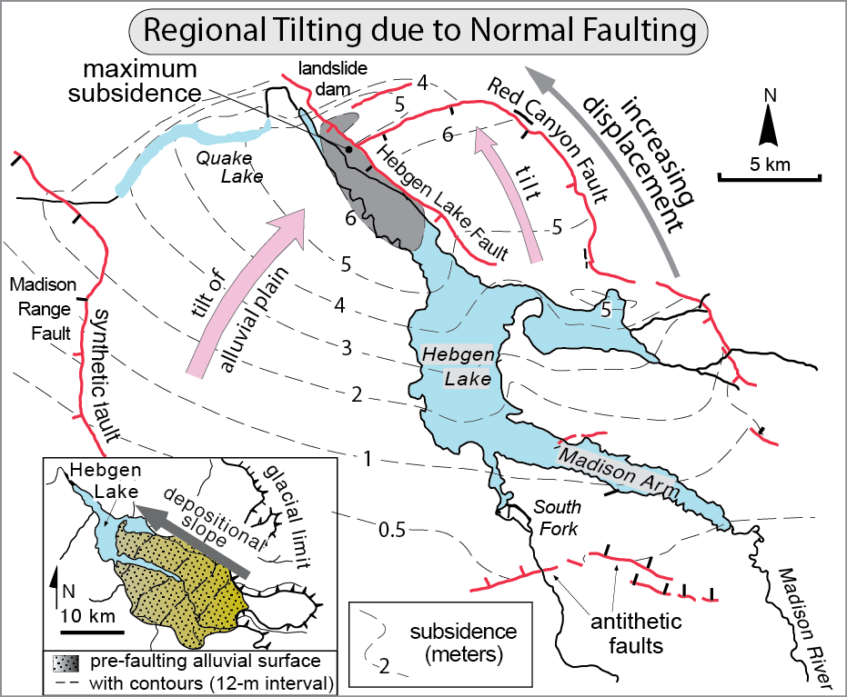
Burbank and Anderson, 2011, Tectonic Geomorphology, Chapter 4

Slide 35
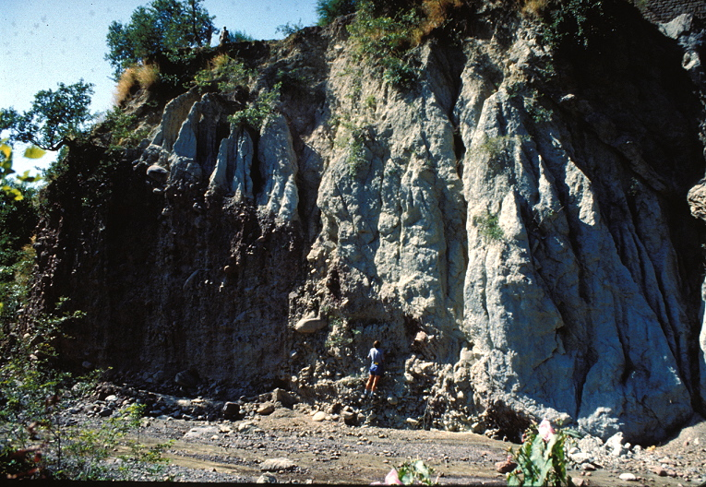
Burbank and Anderson, 2011, Tectonic Geomorphology, Chapter 4

Slide 36
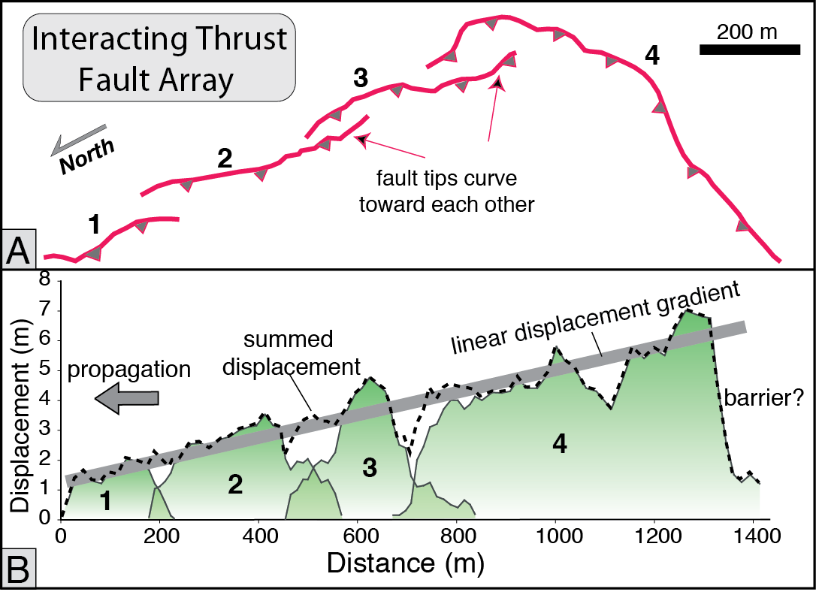
Burbank and Anderson, 2011, Tectonic Geomorphology, Chapter 4

Slide 38
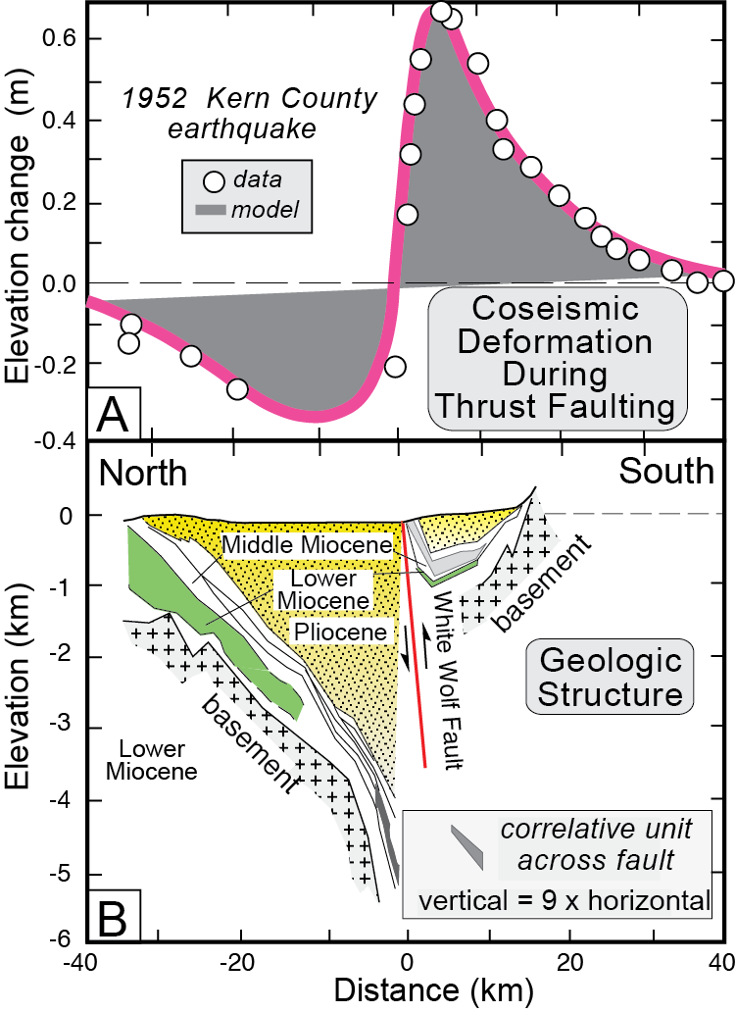
Burbank and Anderson, 2011, Tectonic Geomorphology, Chapter 4

Slide 39
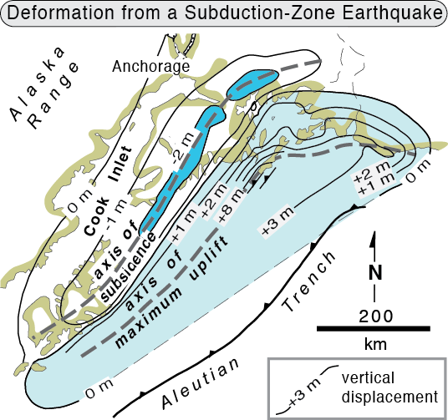
Burbank and Anderson, 2011, Tectonic Geomorphology, Chapter 4

Slide 40
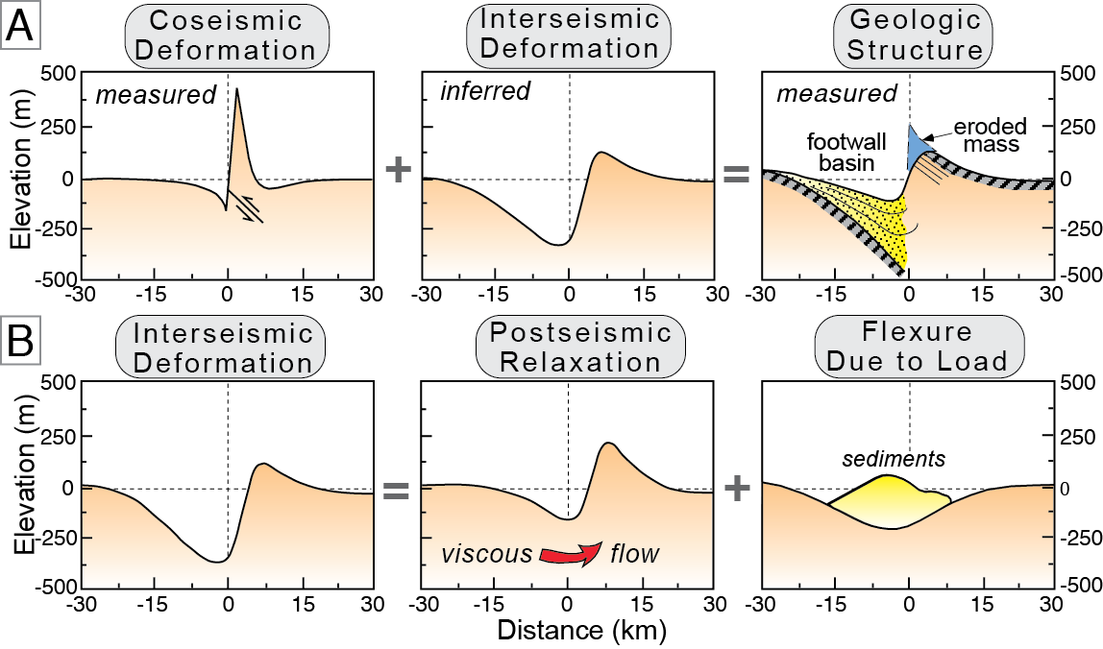
Burbank and Anderson, 2011, Tectonic Geomorphology, Chapter 4

Slide 41
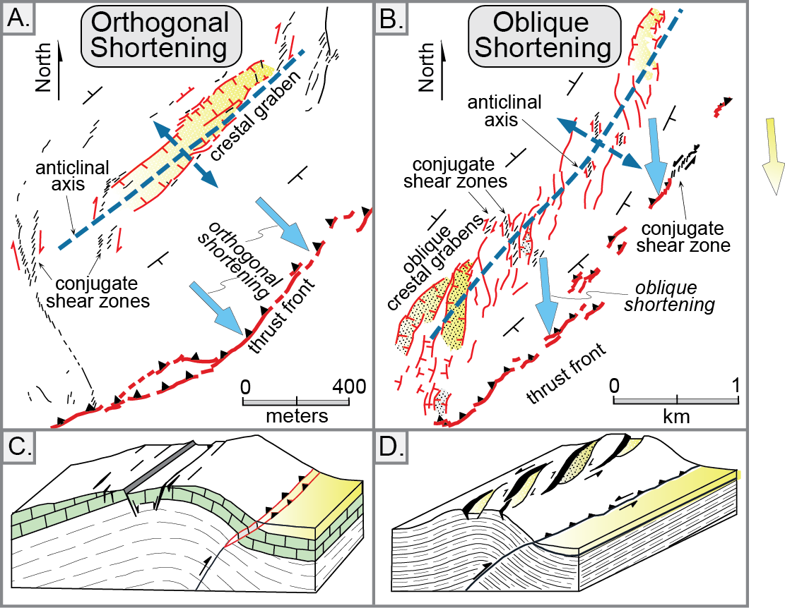
Burbank and Anderson, 2011, Tectonic Geomorphology, Chapter 4

Slide 42
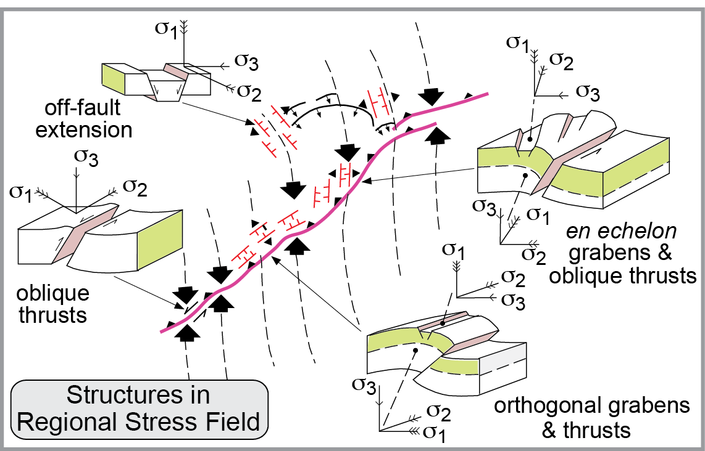
Burbank and Anderson, 2011, Tectonic Geomorphology, Chapter 4

Slide 43
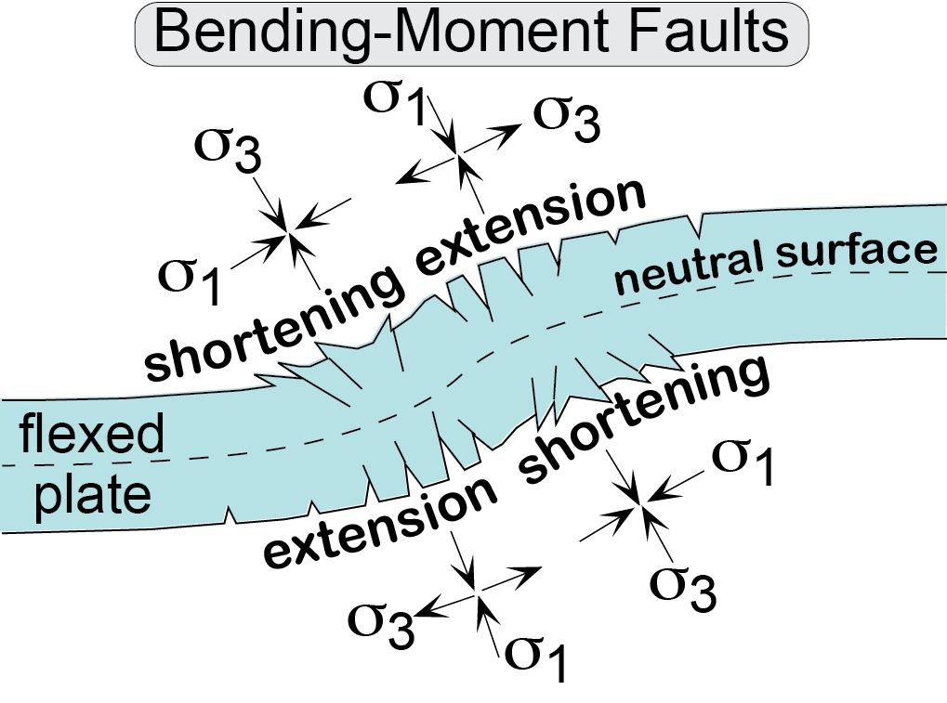
Burbank and Anderson, 2011, Tectonic Geomorphology, Chapter 4

Slide 44
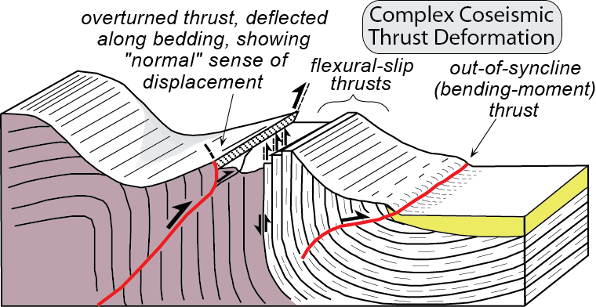
Burbank and Anderson, 2011, Tectonic Geomorphology, Chapter 4

Slide 45
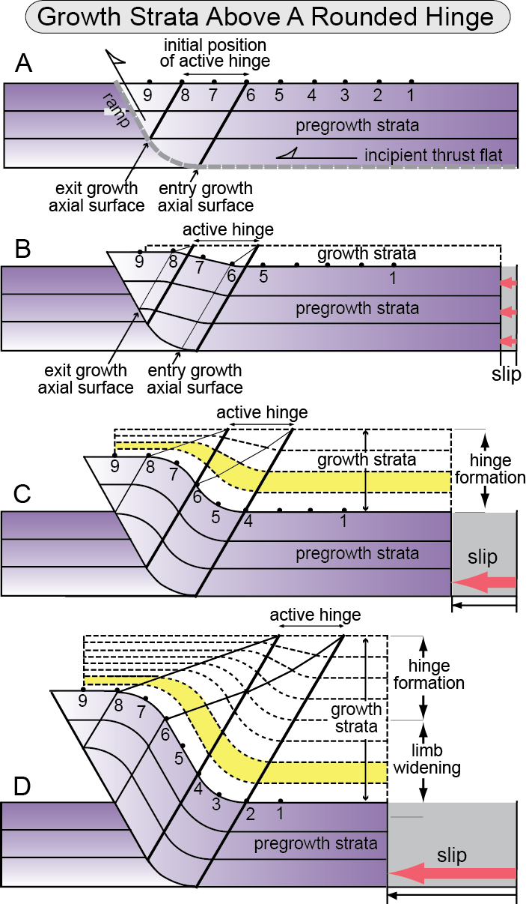
Burbank and Anderson, 2011, Tectonic Geomorphology, Chapter 4

Slide 46
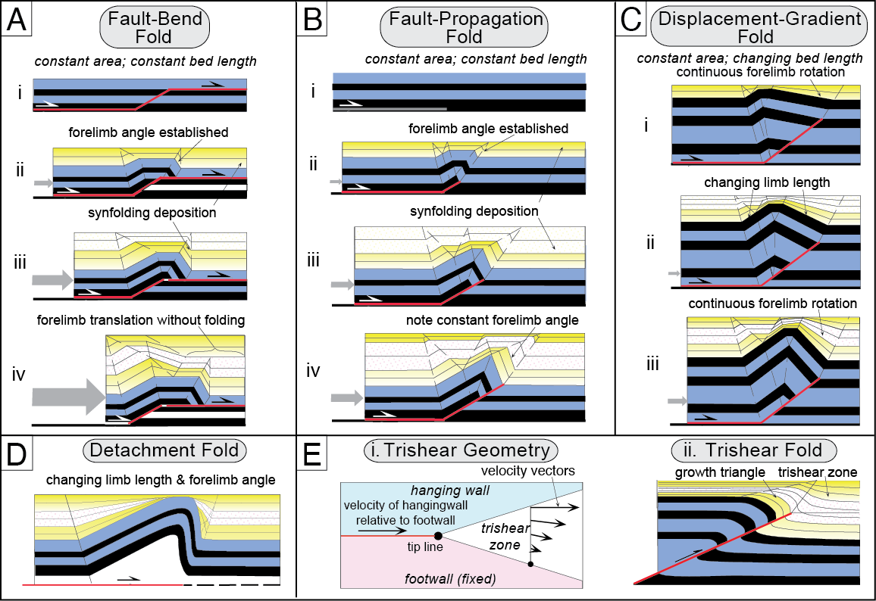
Burbank and Anderson, 2011, Tectonic Geomorphology, Chapter 4

Slide 47
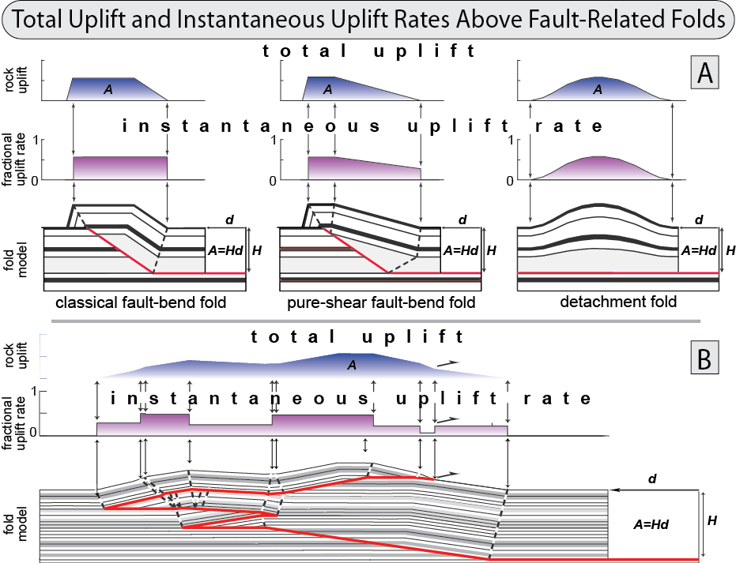
Burbank and Anderson, 2011, Tectonic Geomorphology, Chapter 4

Slide 48
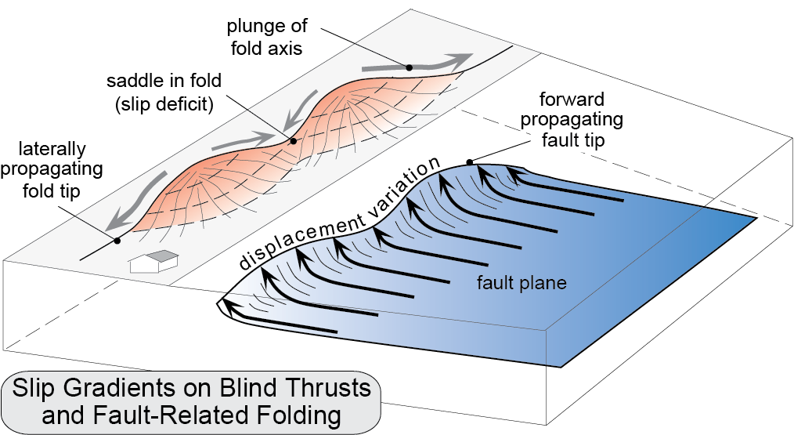
Burbank and Anderson, 2011, Tectonic Geomorphology, Chapter 4

Slide 49
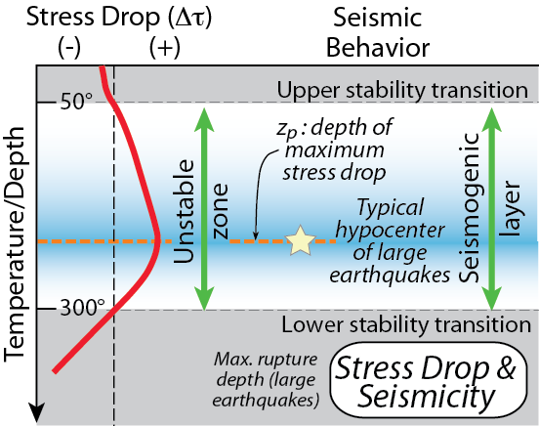
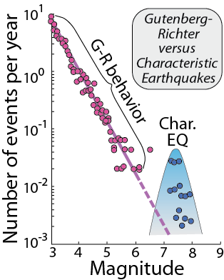
Burbank and Anderson, 2011, Tectonic Geomorphology, Chapter 4

Slide 50
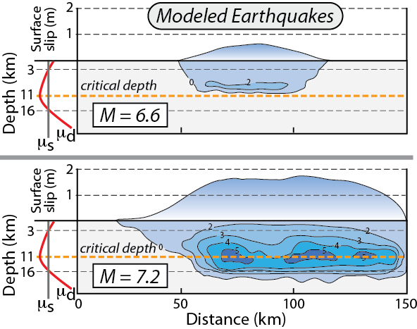
Burbank and Anderson, 2011, Tectonic Geomorphology, Chapter 4

Slide 51
Burbank and Anderson, 2011, Tectonic Geomorphology, Chapter 4

Slide 52
Burbank and Anderson, 2011, Tectonic Geomorphology, Chapter 4

Slide 53
Burbank and Anderson, 2011, Tectonic Geomorphology, Chapter 4

