Slide 1
Tectonic Geomorphology 2nd Edition Burbank and Anderson
Chapter 8: Holocene deformation and landscape responses
Figures, Boxes, Plates, Tables

Slide 2
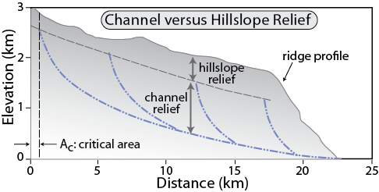
Burbank and Anderson, 2011, Tectonic Geomorphology, Chapter 8

Slide 3
Burbank and Anderson, 2011, Tectonic Geomorphology, Chapter 8

Slide 4
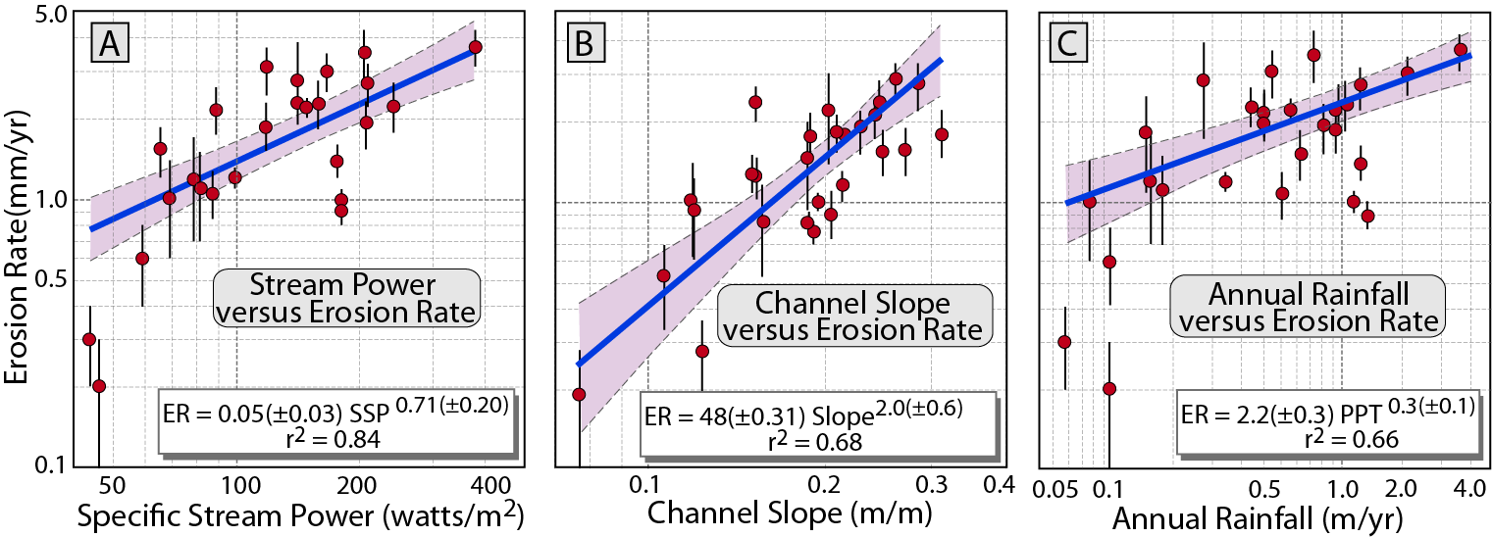
Burbank and Anderson, 2011, Tectonic Geomorphology, Chapter 8

Slide 5
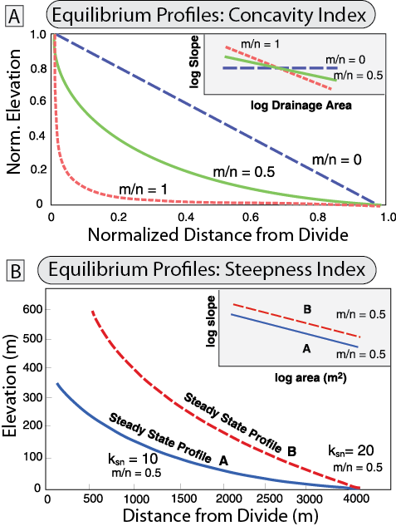
Burbank and Anderson, 2011, Tectonic Geomorphology, Chapter 8

Slide 6
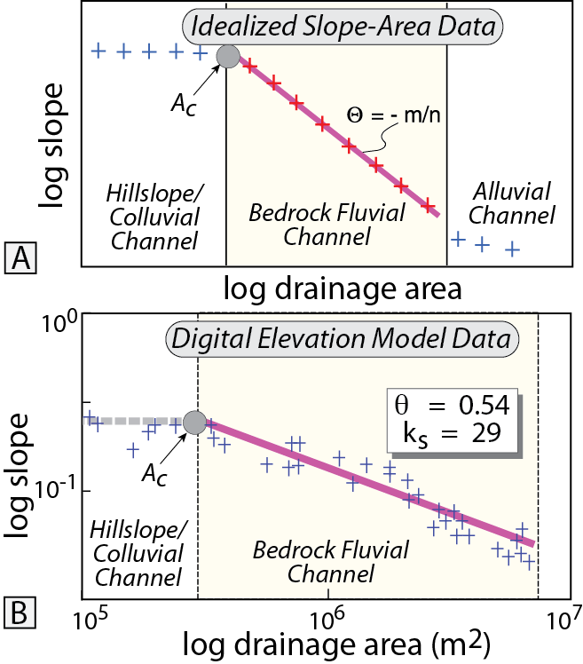
Burbank and Anderson, 2011, Tectonic Geomorphology, Chapter 8

Slide 7
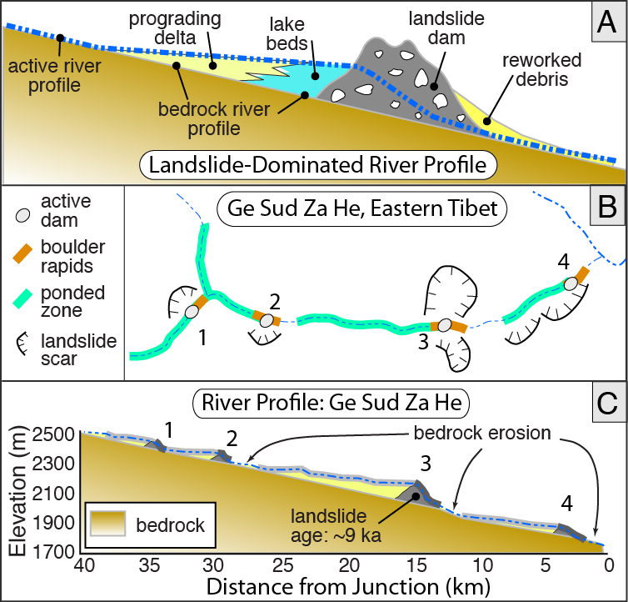
Burbank and Anderson, 2011, Tectonic Geomorphology, Chapter 8

Slide 8
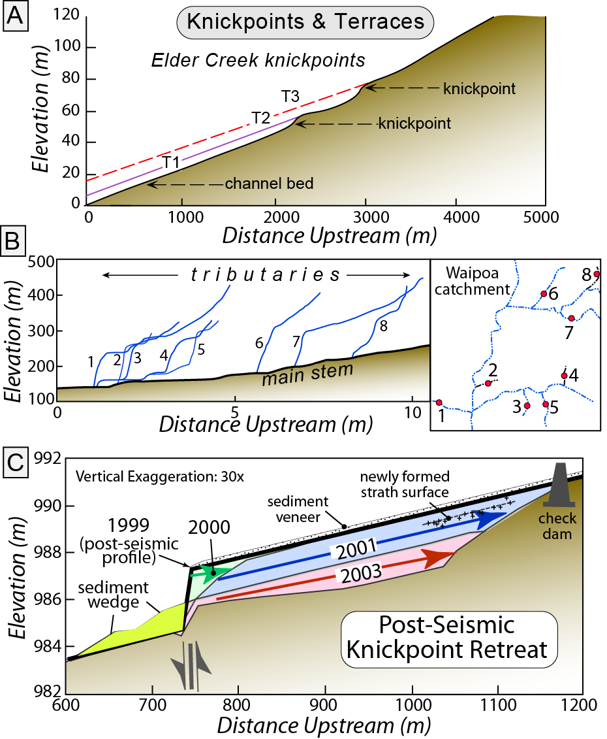
Burbank and Anderson, 2011, Tectonic Geomorphology, Chapter 8

Slide 9
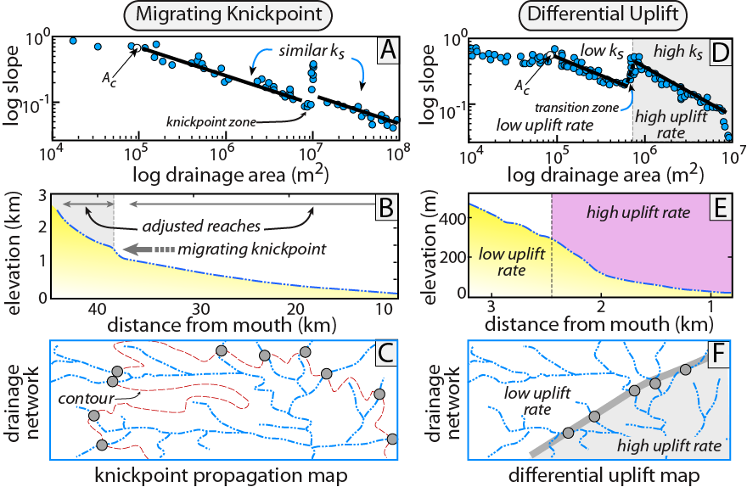
Burbank and Anderson, 2011, Tectonic Geomorphology, Chapter 8

Slide 10
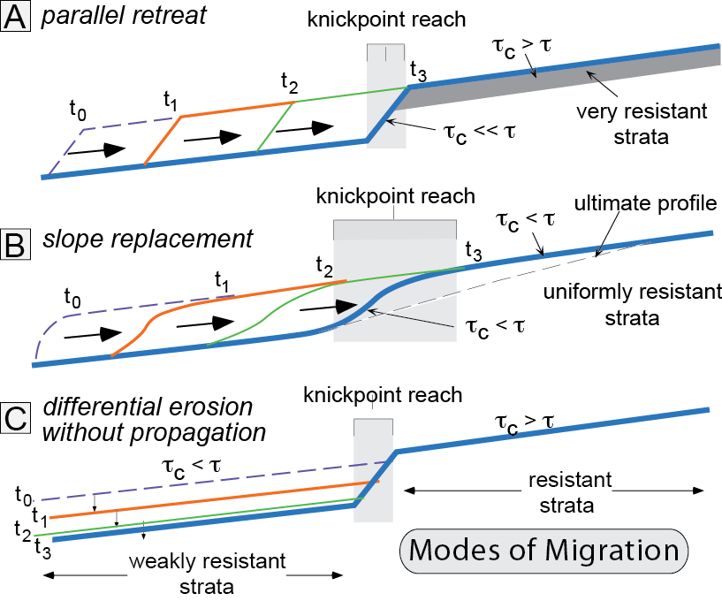
Burbank and Anderson, 2011, Tectonic Geomorphology, Chapter 8

Slide 11
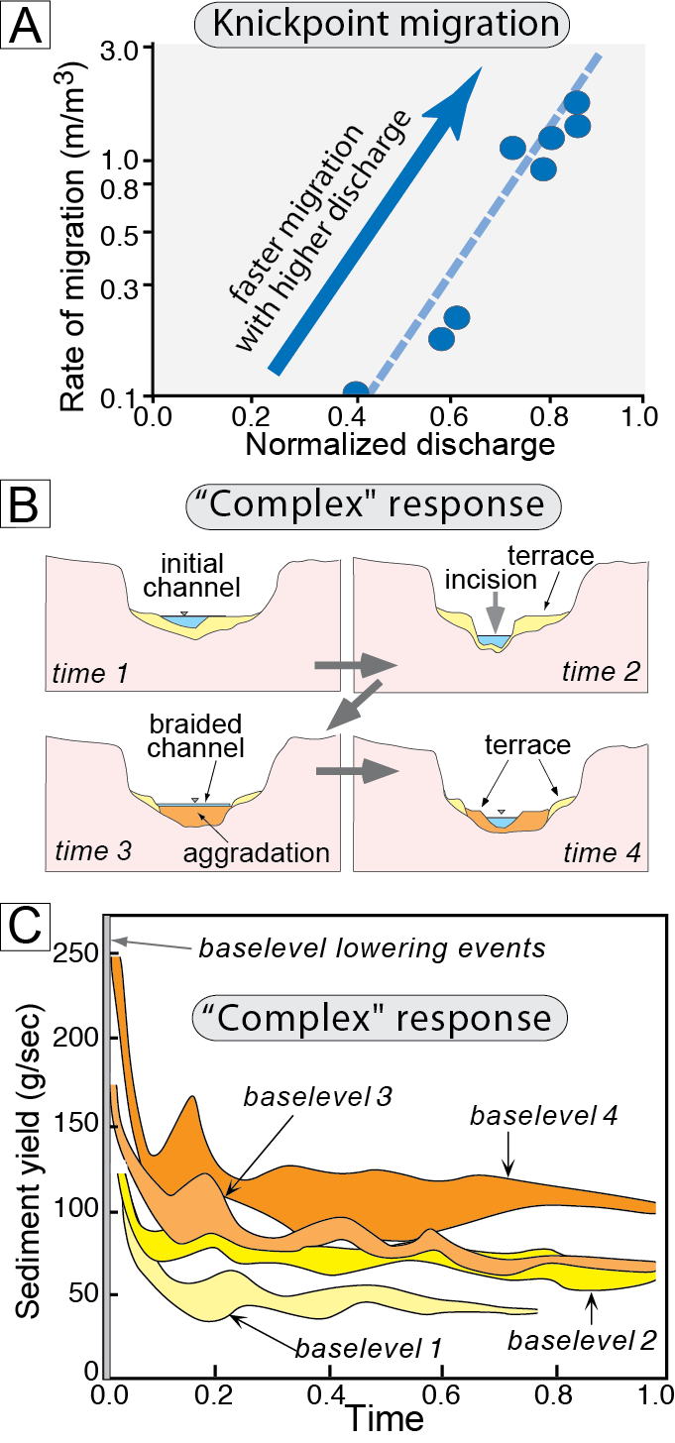
Burbank and Anderson, 2011, Tectonic Geomorphology, Chapter 8

Slide 12
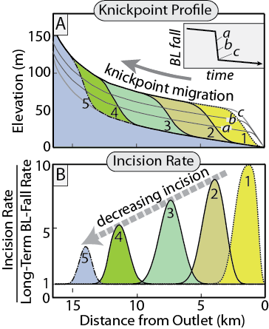
Burbank and Anderson, 2011, Tectonic Geomorphology, Chapter 8

Slide 13
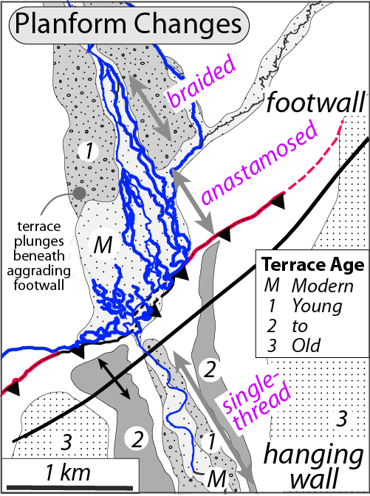
Burbank and Anderson, 2011, Tectonic Geomorphology, Chapter 8

Slide 14
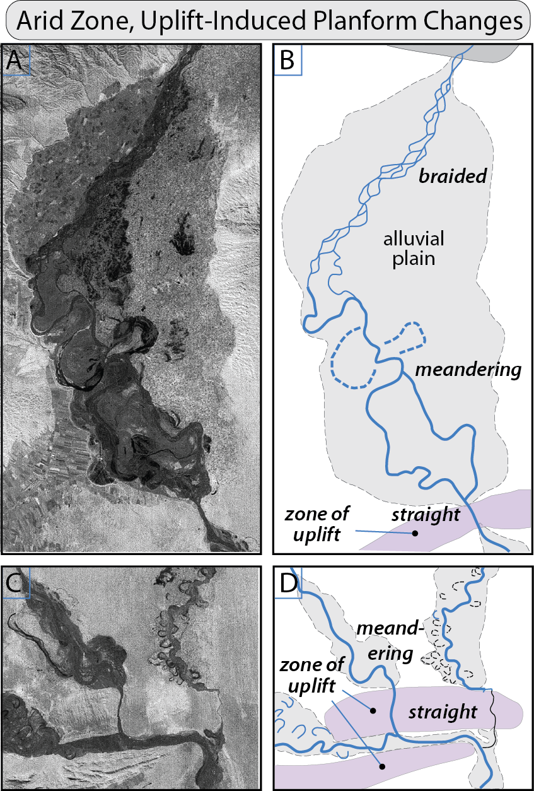
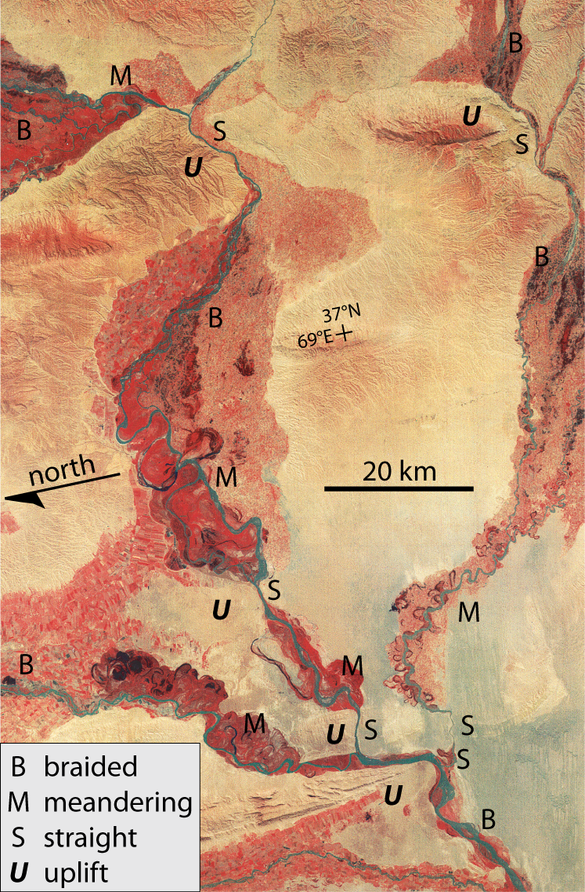
Burbank and Anderson, 2011, Tectonic Geomorphology, Chapter 8

Slide 15
Burbank and Anderson, 2011, Tectonic Geomorphology, Chapter 8

Slide 16
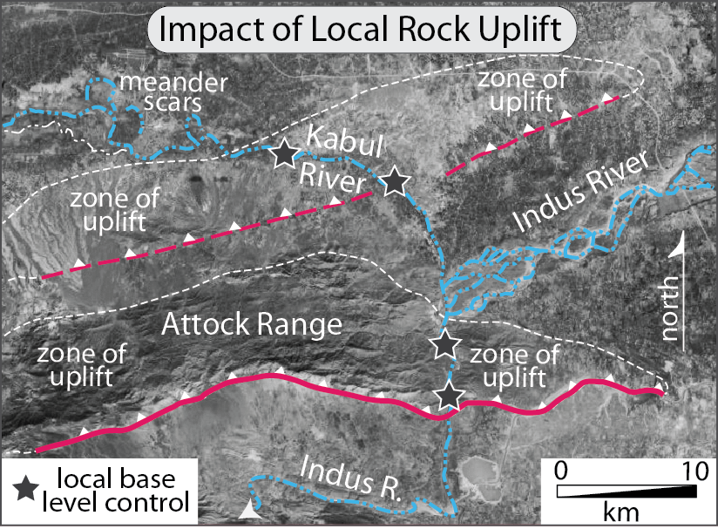
Burbank and Anderson, 2011, Tectonic Geomorphology, Chapter 8

Slide 17
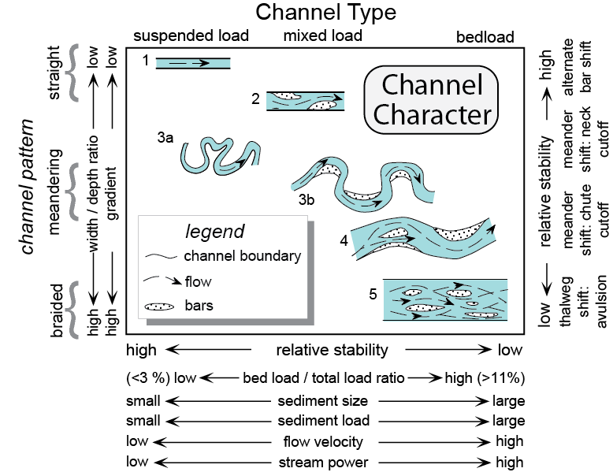
Burbank and Anderson, 2011, Tectonic Geomorphology, Chapter 8

Slide 18
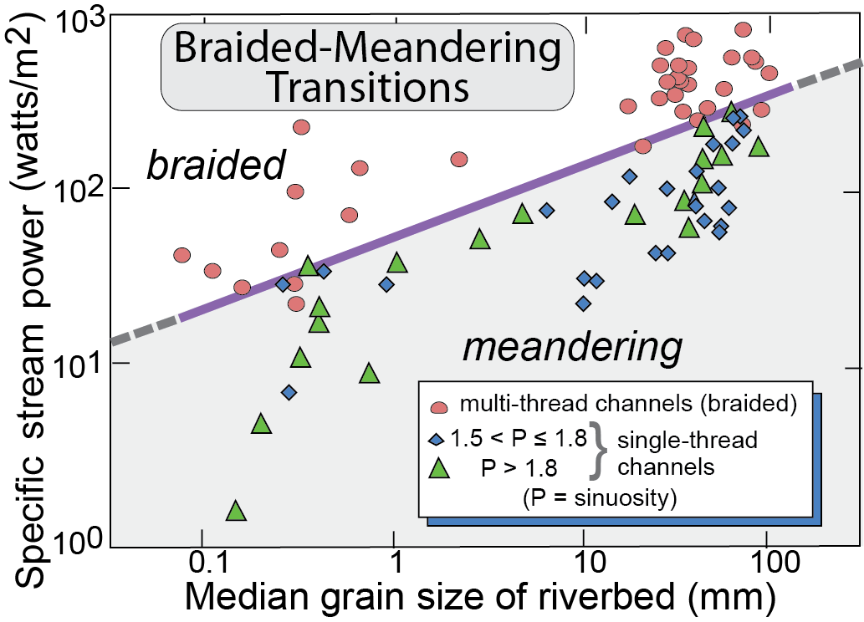
Burbank and Anderson, 2011, Tectonic Geomorphology, Chapter 8

Slide 19
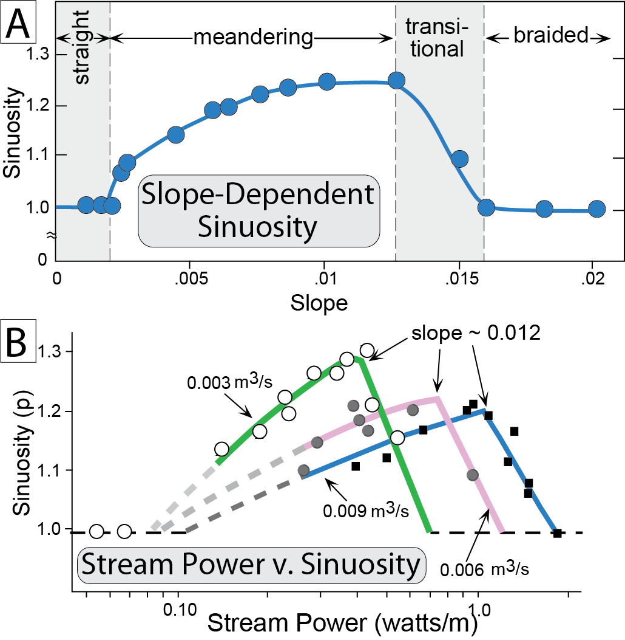
Burbank and Anderson, 2011, Tectonic Geomorphology, Chapter 8

Slide 20
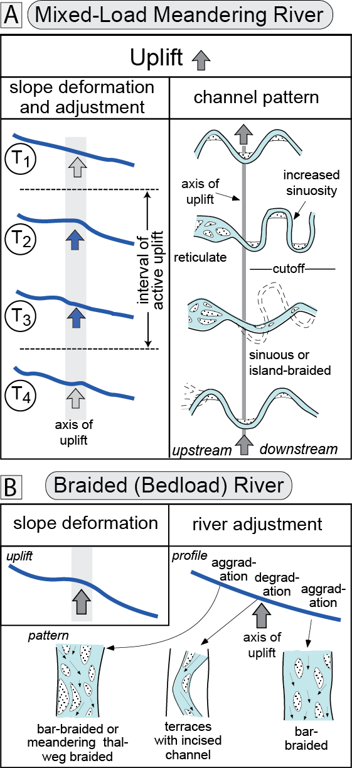
Burbank and Anderson, 2011, Tectonic Geomorphology, Chapter 8

Slide 21
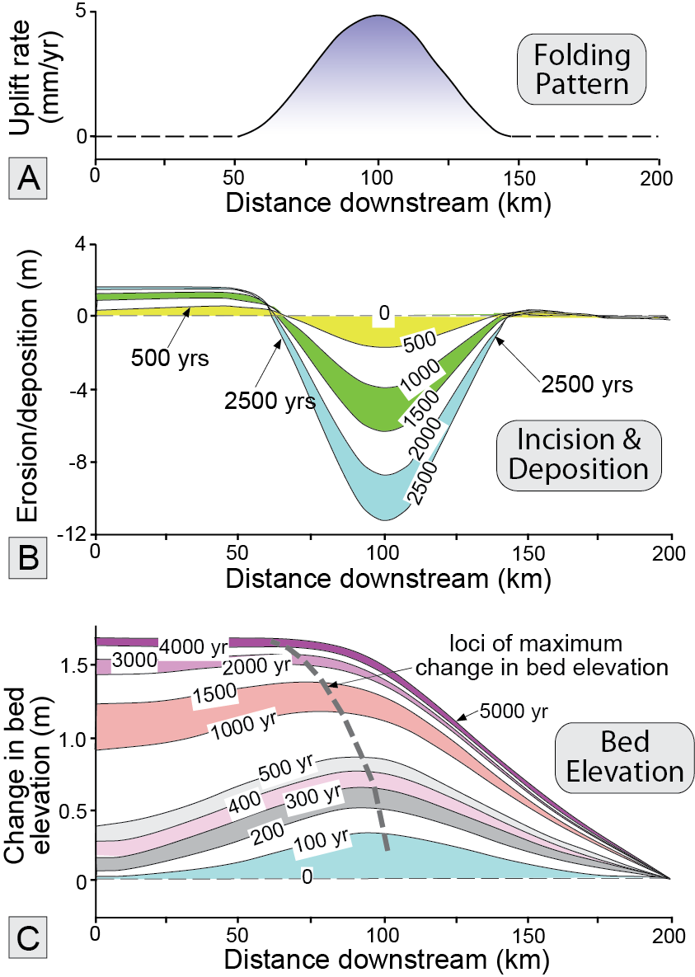
Burbank and Anderson, 2011, Tectonic Geomorphology, Chapter 8

Slide 22
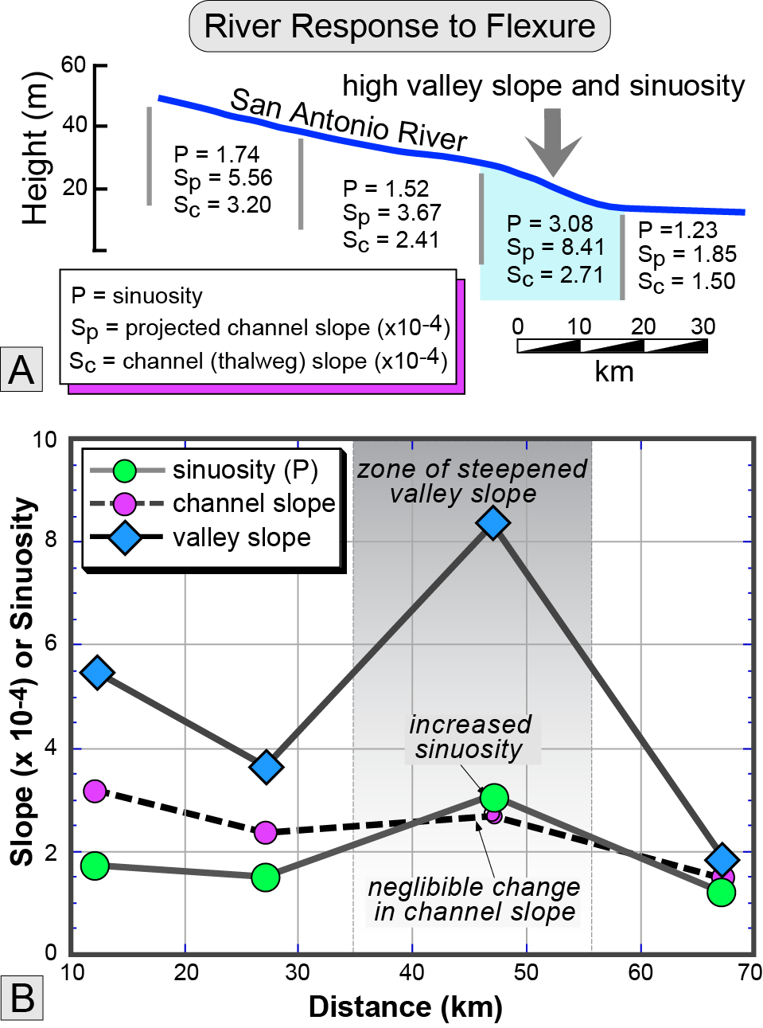
Burbank and Anderson, 2011, Tectonic Geomorphology, Chapter 8

Slide 23
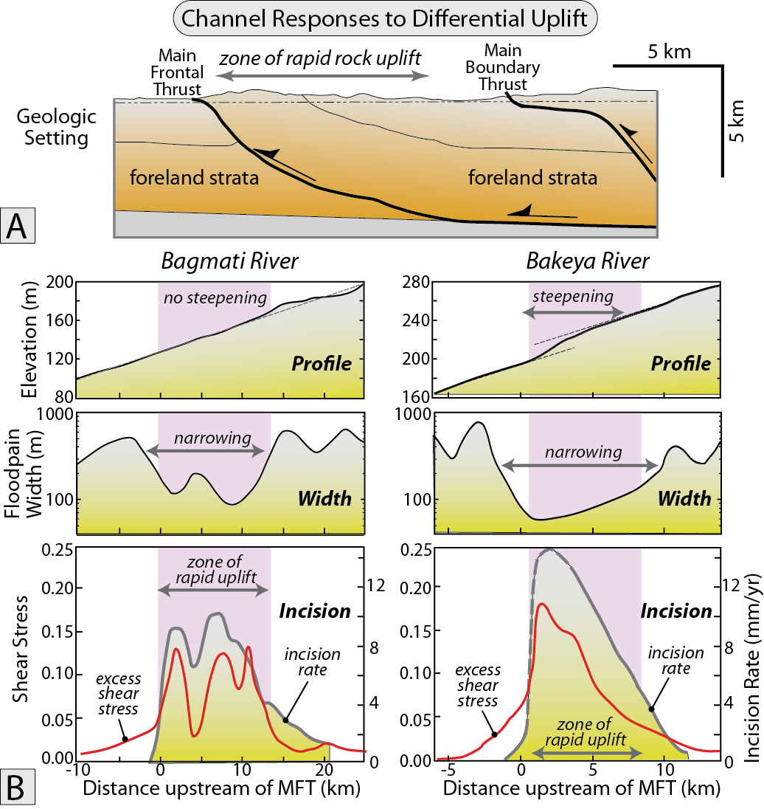
Burbank and Anderson, 2011, Tectonic Geomorphology, Chapter 8

Slide 24
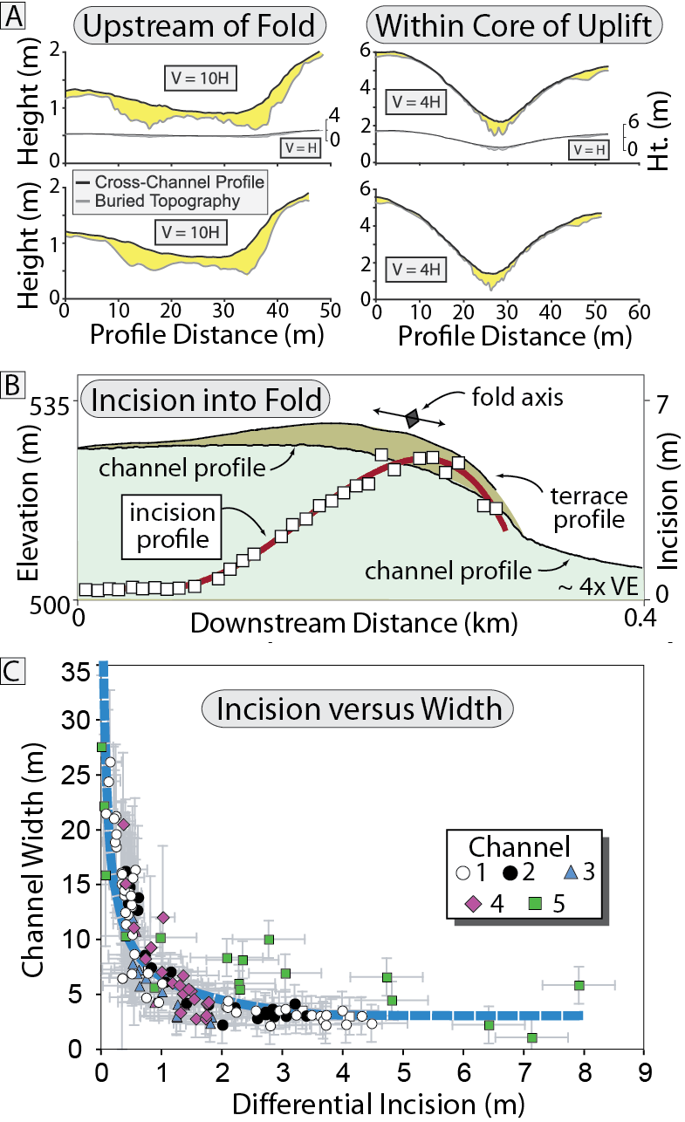
Burbank and Anderson, 2011, Tectonic Geomorphology, Chapter 8

Slide 25
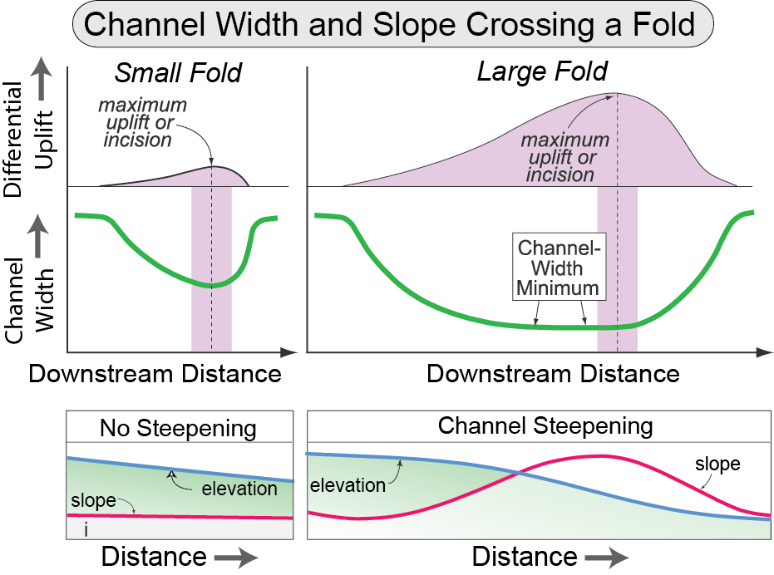
Burbank and Anderson, 2011, Tectonic Geomorphology, Chapter 8

Slide 26
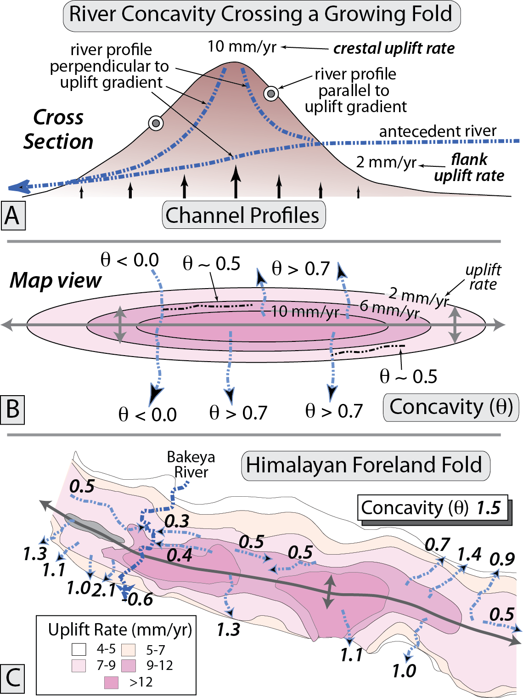
Burbank and Anderson, 2011, Tectonic Geomorphology, Chapter 8

Slide 27
Burbank and Anderson, 2011, Tectonic Geomorphology, Chapter 8

Slide 28
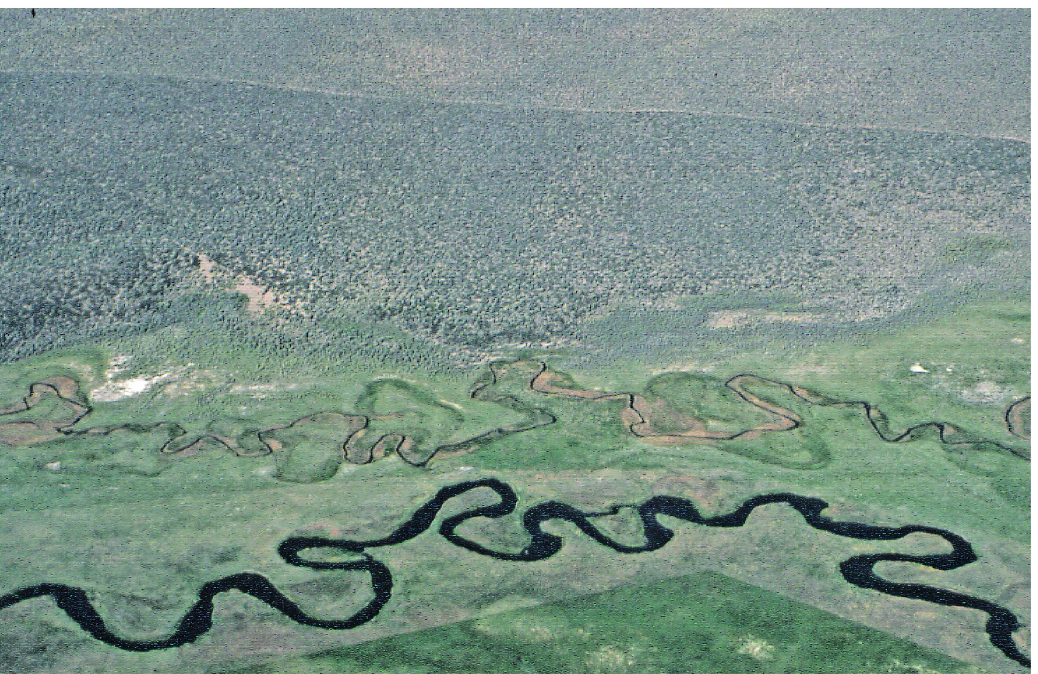
Burbank and Anderson, 2011, Tectonic Geomorphology, Chapter 8

Slide 29
Burbank and Anderson, 2011, Tectonic Geomorphology, Chapter 8

Slide 30
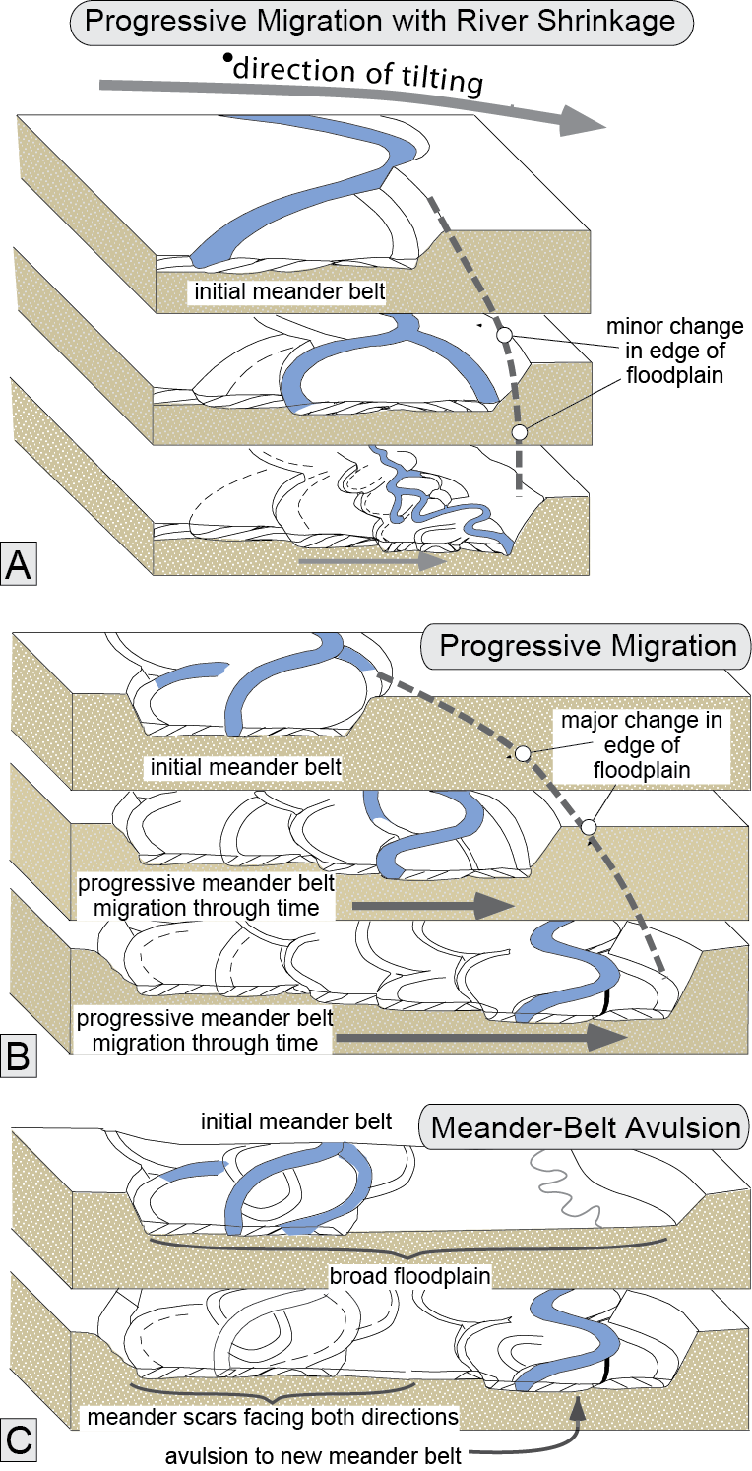
Burbank and Anderson, 2011, Tectonic Geomorphology, Chapter 8

Slide 31
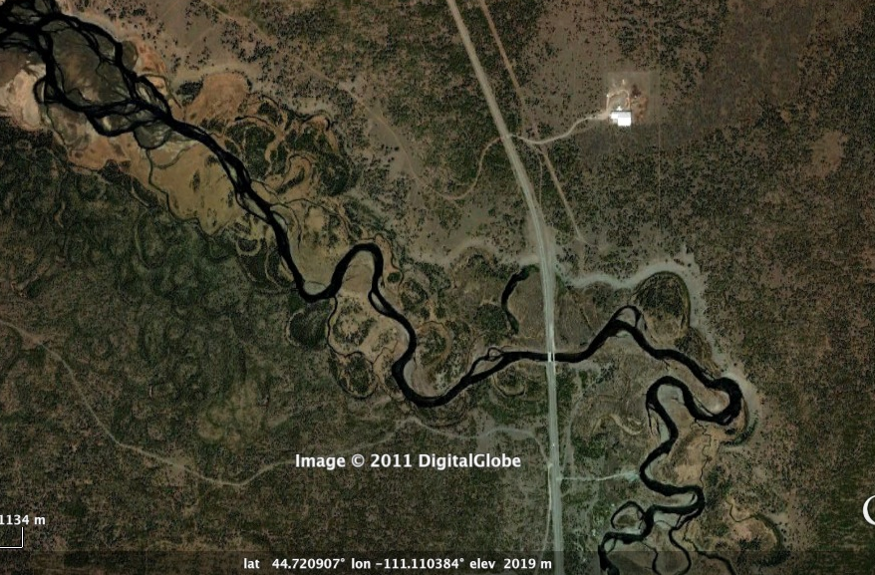
Burbank and Anderson, 2011, Tectonic Geomorphology, Chapter 8

Slide 32
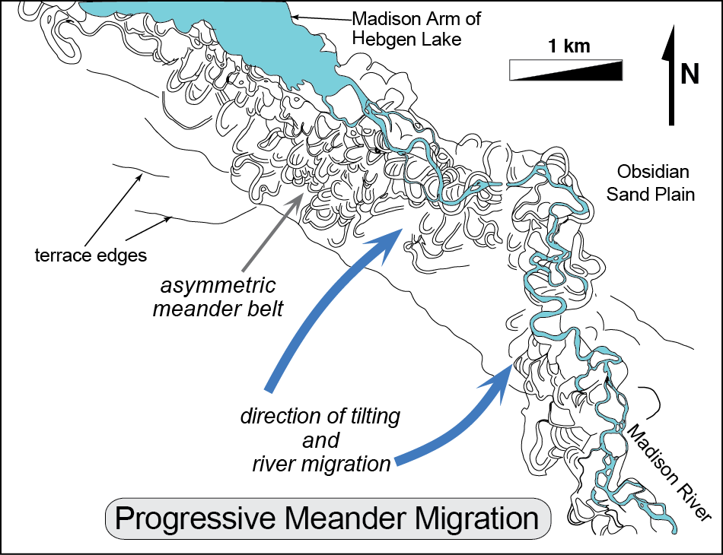
Burbank and Anderson, 2011, Tectonic Geomorphology, Chapter 8

Slide 33
Burbank and Anderson, 2011, Tectonic Geomorphology, Chapter 8

